Slide 1
2024 GOA Pcod assessment
September 2024 Plan Team

Slide 2
Background
Vision for this year was to clean/redevelop input data scripts to then work on modelling analyses
As you’ll soon see, redevelopment of data scripts hit some bumps that required a bit of attention – took much longer than anticipated
Data code redeveloped, streamlined, and documented
A number of redundancies and dead ends removed
Resulted in reduction of the number of lines of code and ~30% reduction in run time (8 min vs 12 min)

Slide 3
Outline
Data updates/recommended base changes to model input files
Additional recommended data changes: Update ageing error, fishery length comps, length comp binning
Evaluated apportionment changes: inclusion of AFSC longline survey
Evaluated model changes: survey/fishery selex, ISS
Upcoming assessment work
Forgiveness & permission…

Slide 4
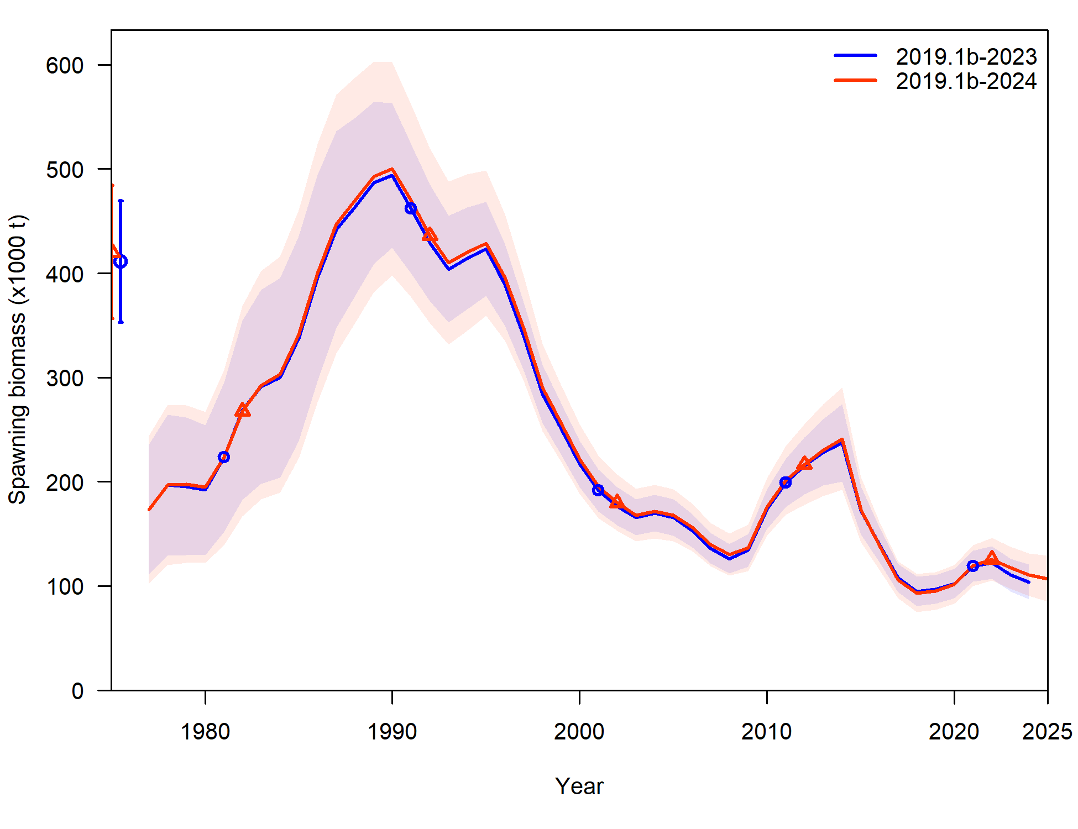
Base data updates (2019.1b-2024)
Noteworthy difference: Trawl survey
GAP cleaned up old haul data, only includes specimen data associated with a haul that is used to compute abundance
Resulted in minor differences in early trawl survey time series for abundance and comp data
Updating fishery data update results in slight uptick in spawning biomass at end of time-series compared to 2023 assessment

Slide 5
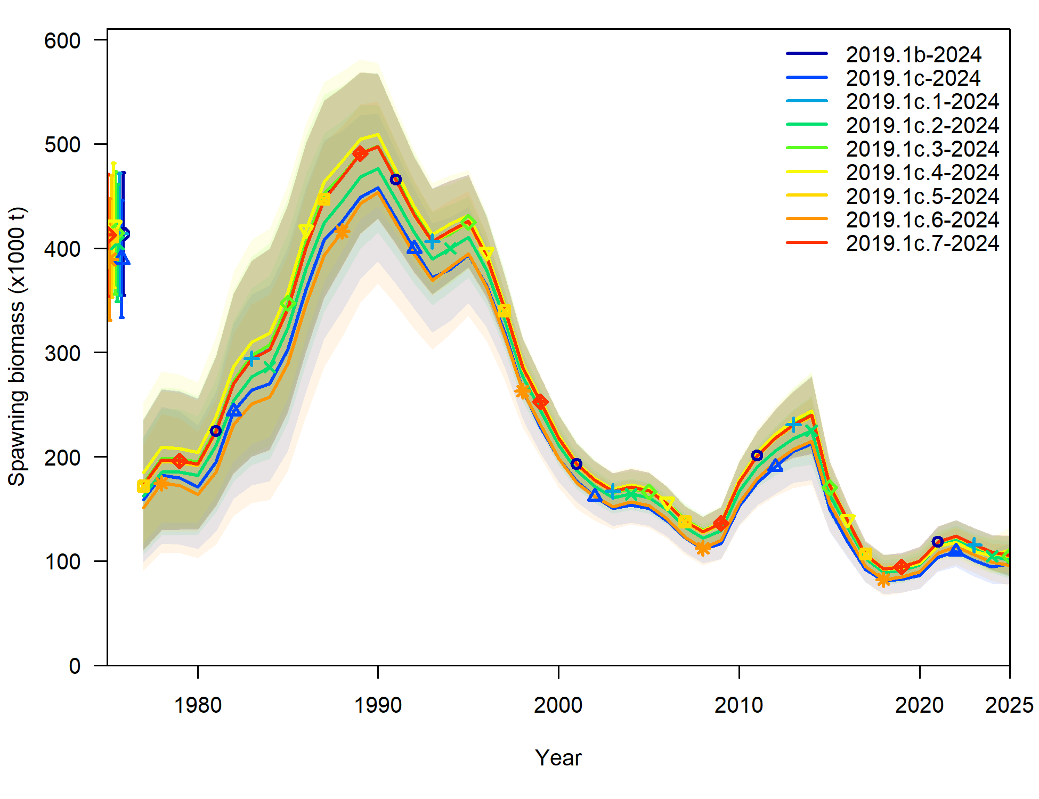
Input data file changes
7 changes recommended: denoted as 2019.1c.#
All added 1 at a time to model 2019.1b to evaluate sensitivity of model to each change individually
BLUF: no substantial changes to trend, but will end up with shift in SSB

Slide 6
Input data file changes
LL survey:
Log-normal computation for RPN SD hadn’t been applied (but was applied to bottom trawl survey index), now is applied – 2019.1c.1
Length comps off by a cm (i.e., 25 cm fish became 26 cm) – 2019.1c.2
Length comps season had been set at 1 (Jan), when should have been set at 7 (Jul) – 2019.1c.3
Fishery length comps:
ISS set at total number of hauls sampled (max 200), but filtered hauls to a certain sample size in expansion, set at number of hauls actually used in expansion (max 200) – 2019.1c.4

Slide 7
Input data file changes
All length comps:
Set plus bin at 104 cm rather than 116 cm (<2% of years ꓯ data >0.01) – 2019.1c.5
Trawl survey conditional age-at-length
Season had been set at 1 (Jan), when should have been set at 7 (Jul) – 2019.1c.6
Consistency across assessments (SSC request):
Turn off forecast recruitment parameters – 2019.1c.7

Slide 8
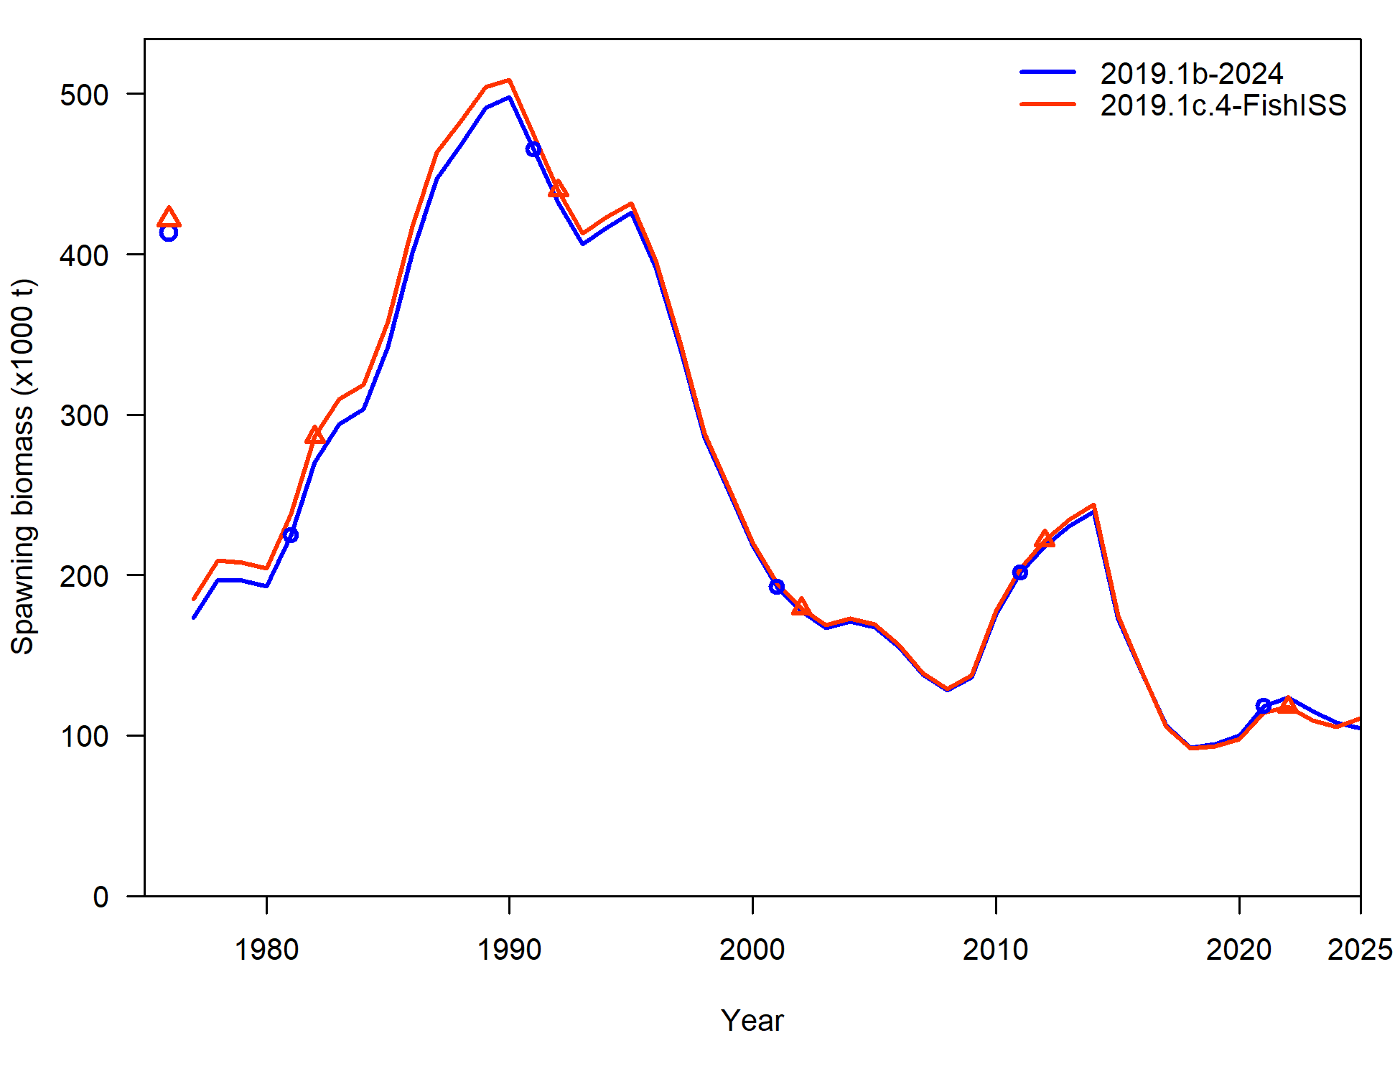
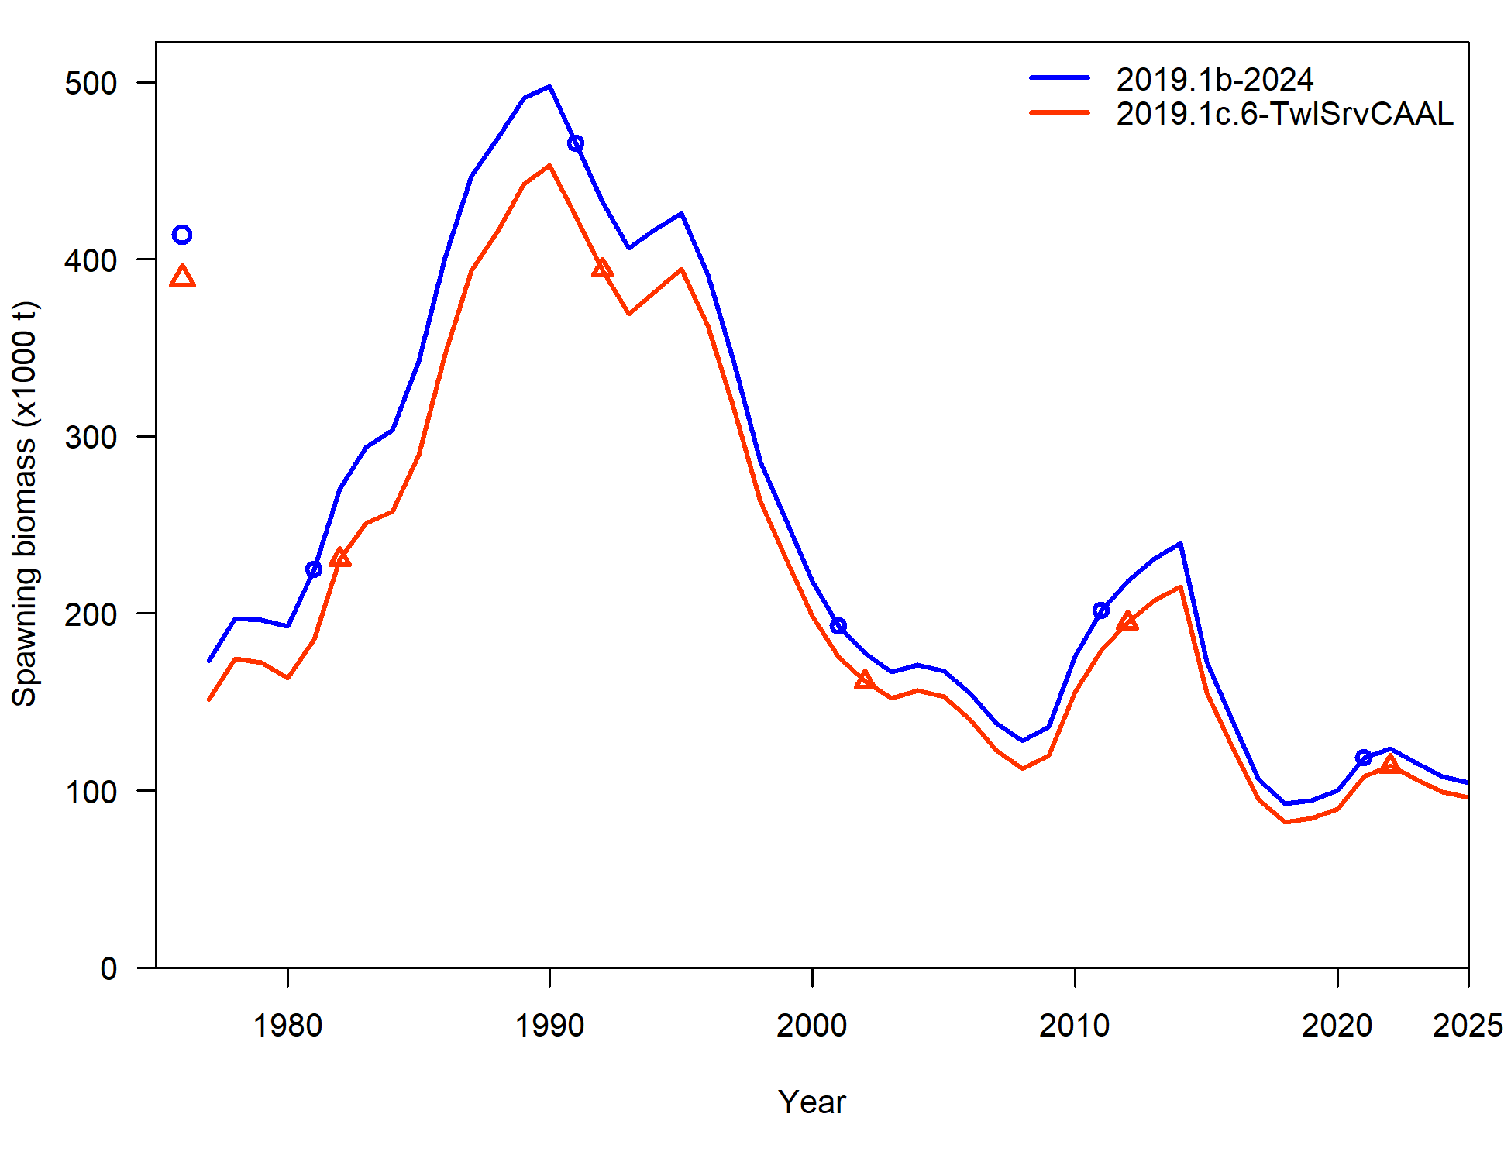
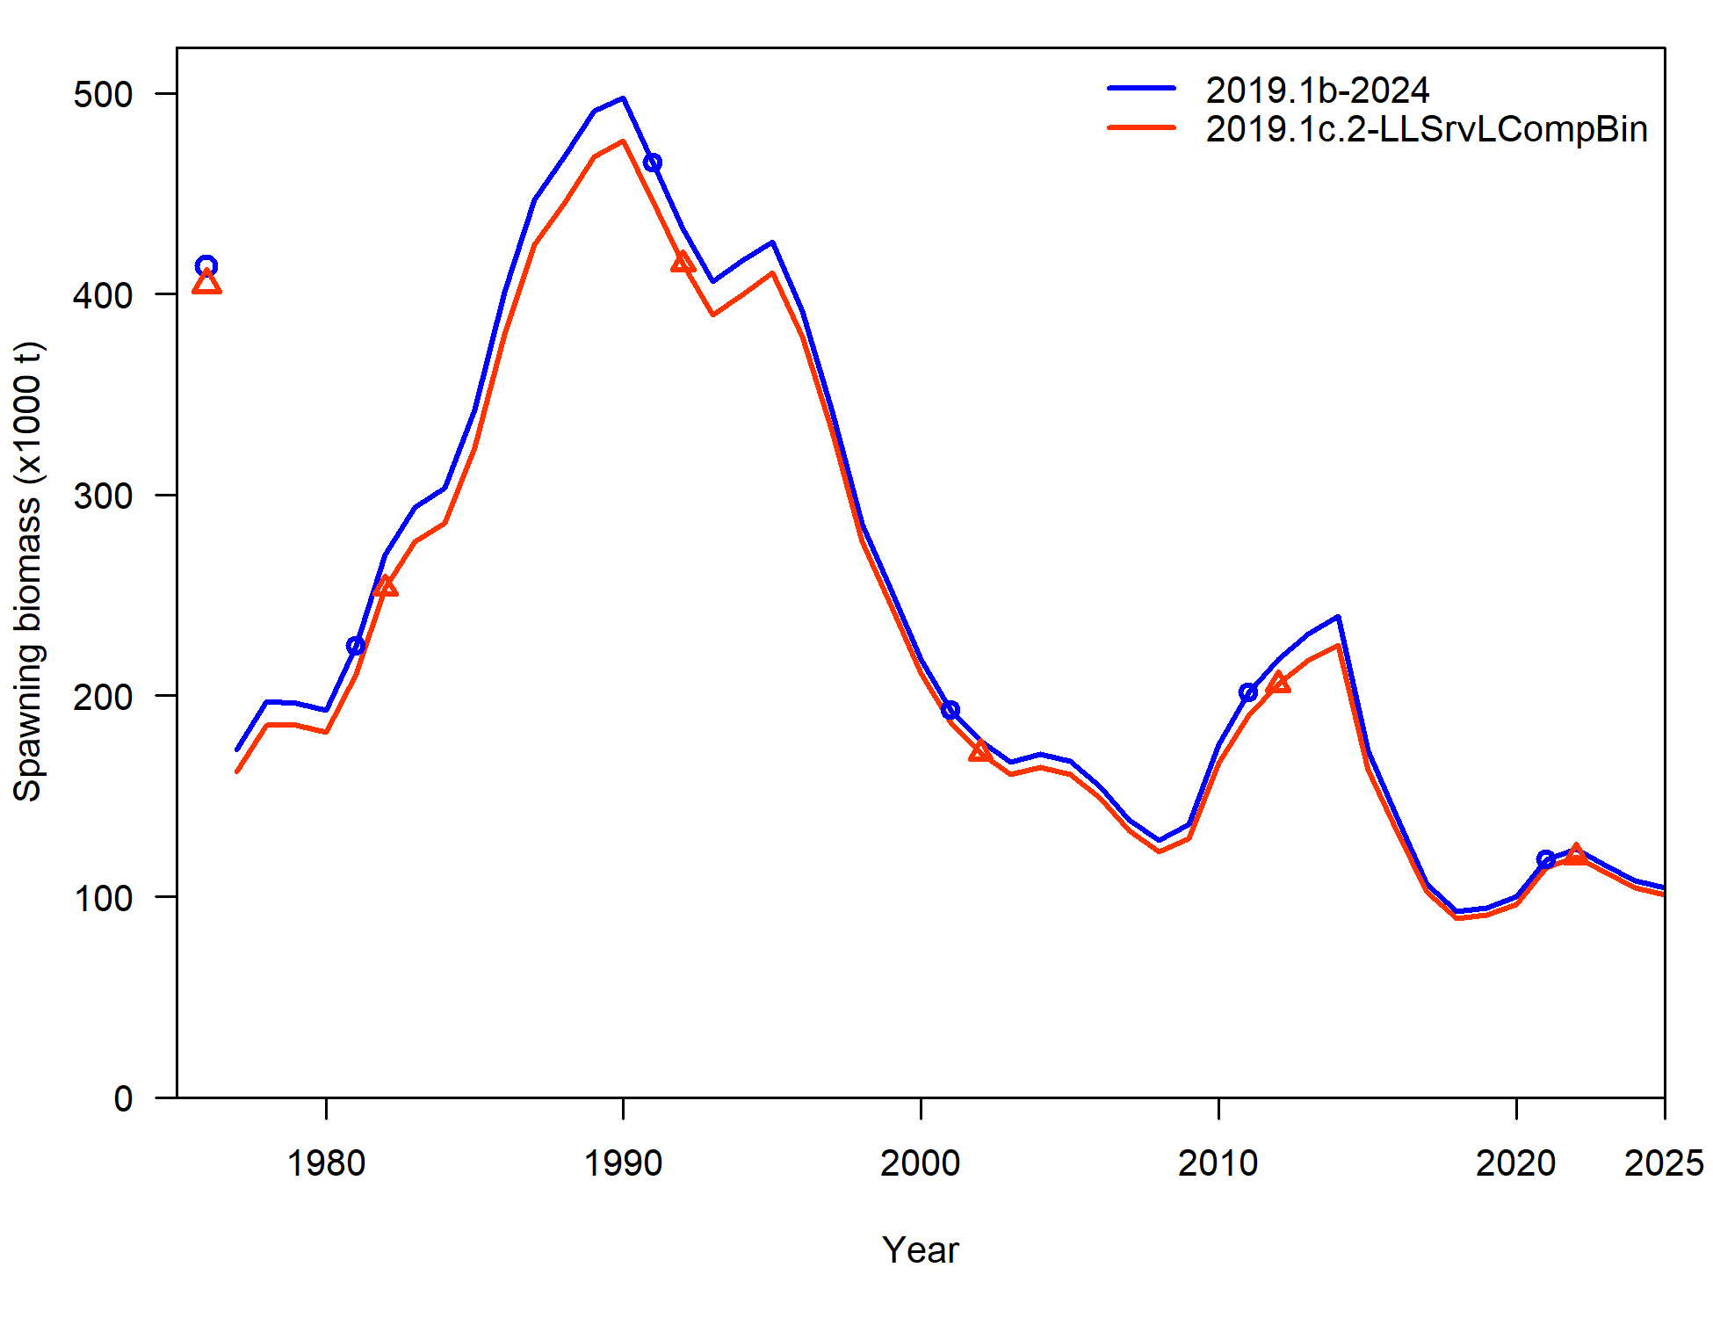
Input data file changes
Average % difference in SSB (from 2019.1b):
Model | %diff
2019.1c.1 | -0.06%
2019.1c.2 | -4.50%
2019.1c.3 | 0.20%
2019.1c.4 | 1.63%
2019.1c.5 | -0.33%
2019.1c.6 | -10.59%
2019.1c.7 | -0.05%

Slide 9
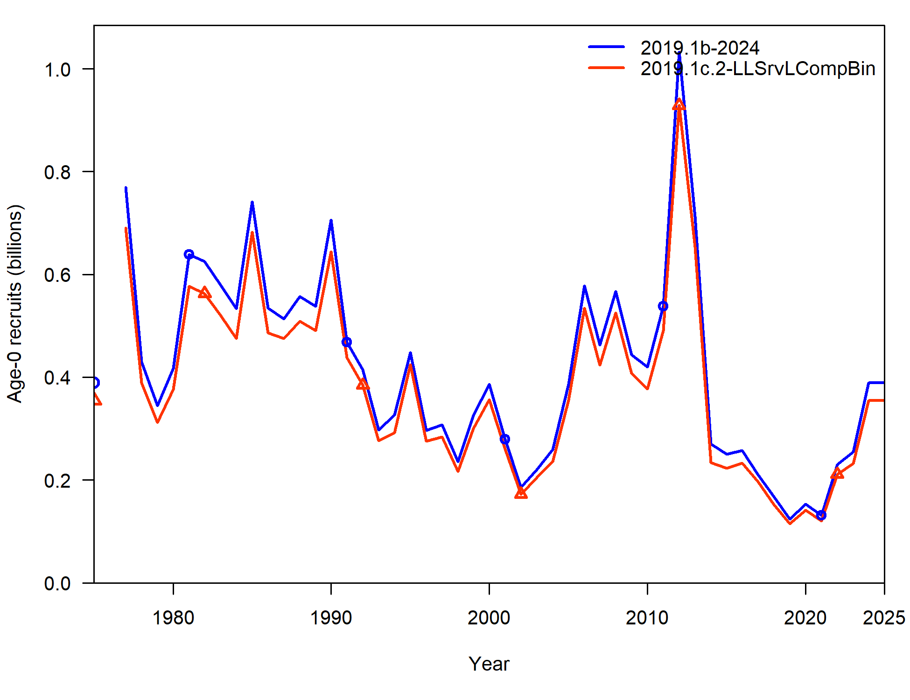
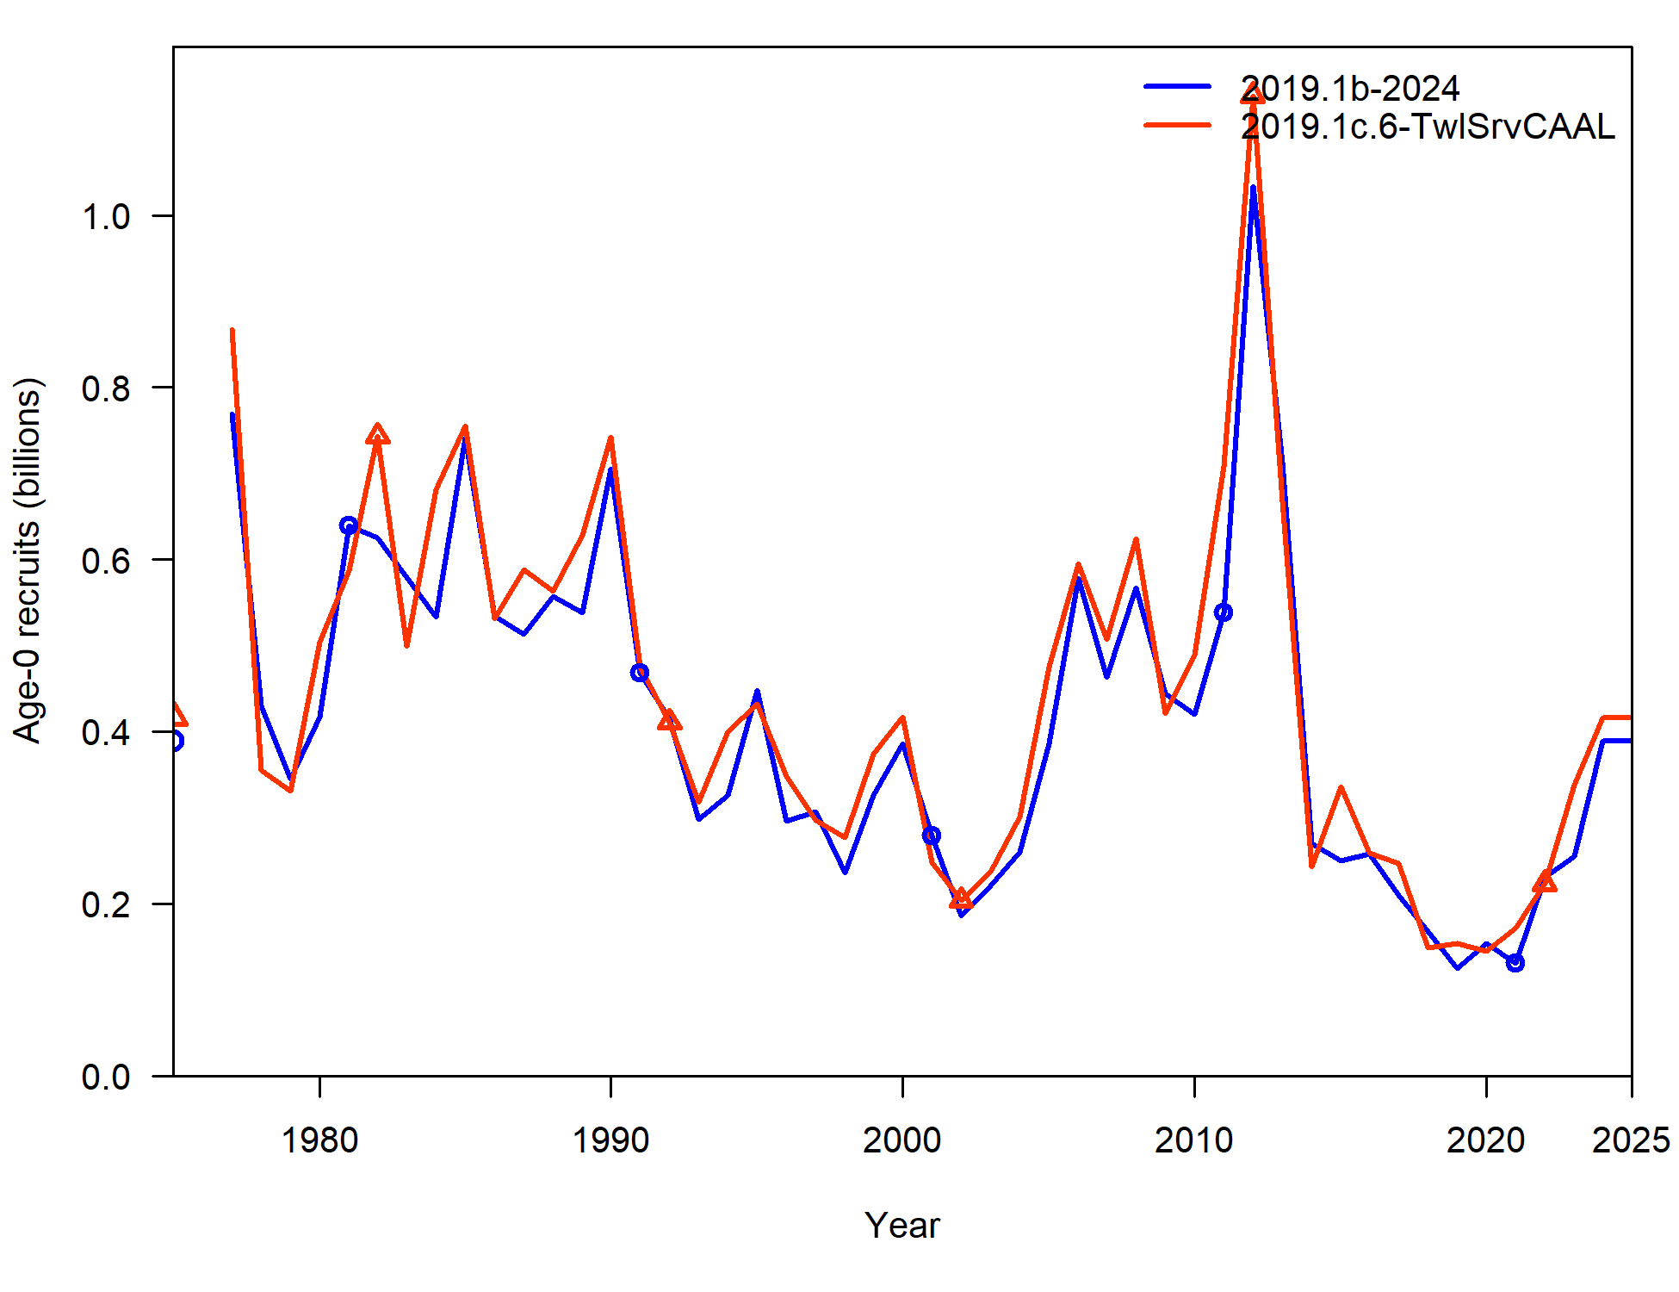
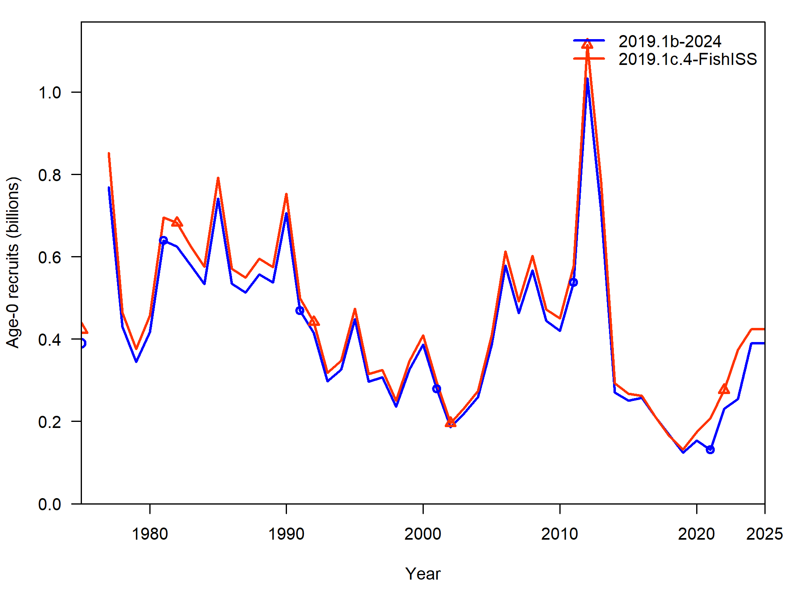
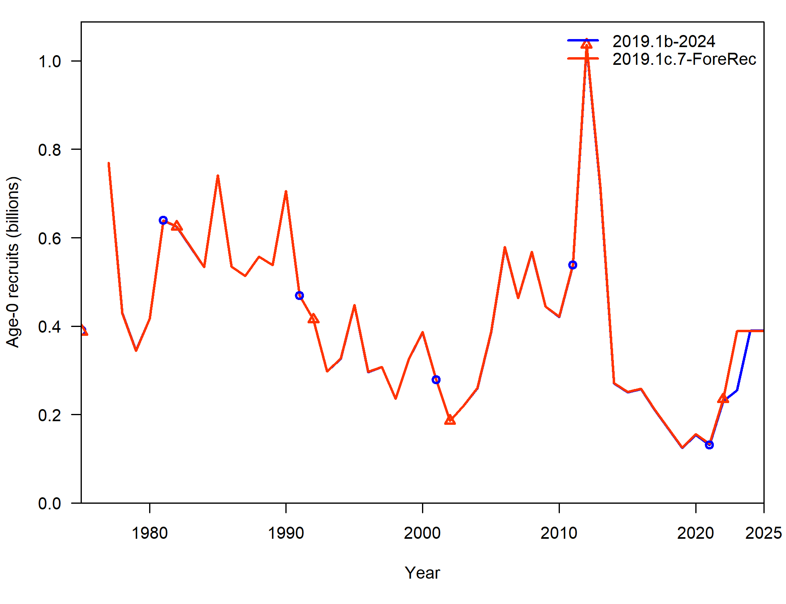
Input data file changes
Average % difference in Recruitment:
Model | %diff
2019.1c.1 | -0.09%
2019.1c.2 | -8.57%
2019.1c.3 | -0.89%
2019.1c.4 | 8.93%
2019.1c.5 | 0.79%
2019.1c.6 | 8.07%
2019.1c.7 | 1.30%

Slide 10
Input data file changes
Neg log-likelihood components:
Component | 2019.1b | 2019.1c.2: LLSrvBin | 2019.1c.4: FishISS | 2019.1c.6: TwlCAAL
TOTAL | 3050.99 | 3043.46 | 2915.88 | 3026.08
Catch | 1.21E-12 | 2.47E-12 | 1.17E-12 | 5.19E-12
Survey | -3.78 | -5.13 | -8.96 | -3.44
Length_comp | 1868.43 | 1861.86 | 1743.21 | 1866.58
Age_comp | 1180.16 | 1180.36 | 1177.15 | 1156.07
Recruitment | -4.86 | -4.93 | -5.97 | -3.95
InitEQ_Regime | 3.10 | 3.45 | 2.77 | 3.52
Forecast_Recruitment | 0.41 | 0.41 | 0.03 | 0.10
Parm_priors | 1.02 | 0.92 | 1.12 | 1.07
Parm_softbounds | 0.01 | 0.01 | 0.01 | 0.01
Parm_devs | 6.50 | 6.51 | 6.51 | 6.12

Slide 11
Input data file changes
Key parameters:
Parameter | 2019.1b | 2019.1c | 2019.1c.2: LLSrvBin | 2019.1c.4: FishISS | 2019.1c.6: TwlCAAL
NatM | 0.46 | 0.47 | 0.45 | 0.47 | 0.46
NatM: 14-16 | 0.80 | 0.82 | 0.78 | 0.82 | 0.81
lnR | 12.87 | 12.99 | 12.78 | 12.96 | 12.94
q_twl | 1.07 | 1.19 | 1.12 | 1.07 | 1.19
q_ll | 1.06 | 1.08 | 1.04 | 1.05 | 1.15
q_llenv | 1.46 | 1.28 | 1.64 | 1.55 | 0.91

Slide 12
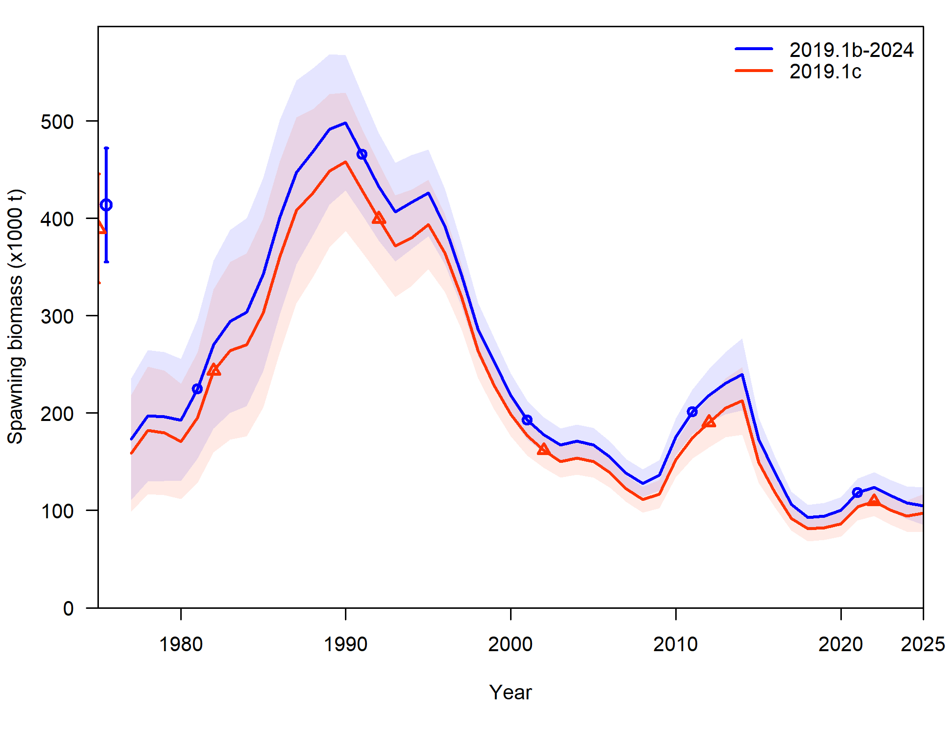
Input data file changes
Input data changes:
Provide a number of necessary corrections
Starts to increase consistency across cod assessments
Recommend new model 2019.1c

Slide 13
Data updates: ageing error & bias
Current ageing error:
Based on GOA reader-tester data up to 2017
No error for age-1 & 2, age-3 SD = 0.57 linear to age-10 SD = 1.16
Current ageing bias:
Bias for data pre-2007 implemented in Barbeaux et al. 2019
Estimates bias as unconstrained parameters at age-3 and age-10 (linear between)

Slide 14
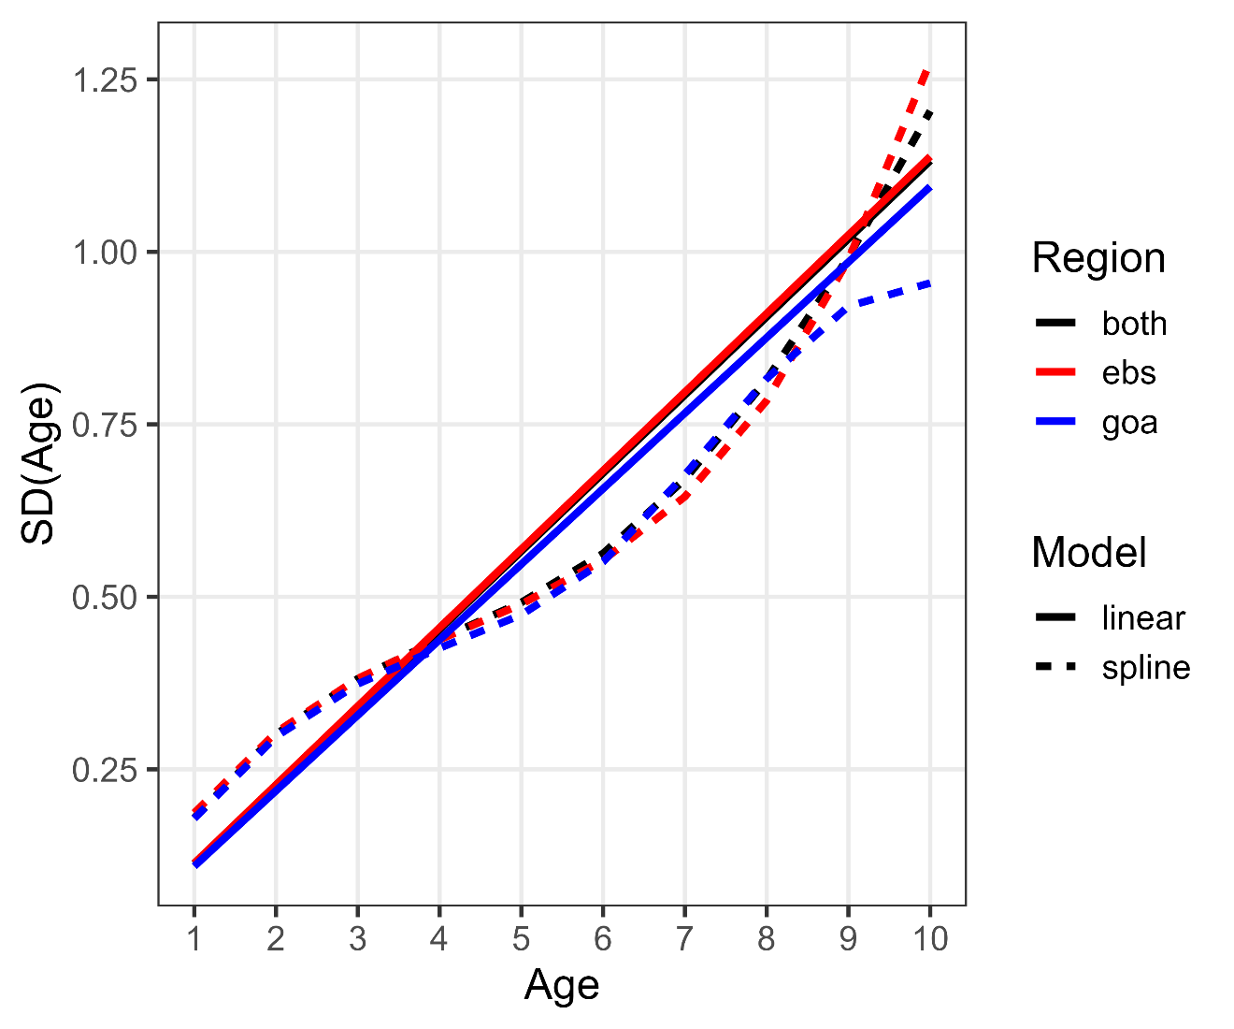
Data updates: ageing error
Ageing error parameters: Update reader-tester data through 2023 within AgeingError R-package
Propose:
Pool GOA-EBS
Continue with linear method
Change to age-1 (SD = 0.11) → age-10 (SD = 1.13)

Slide 15
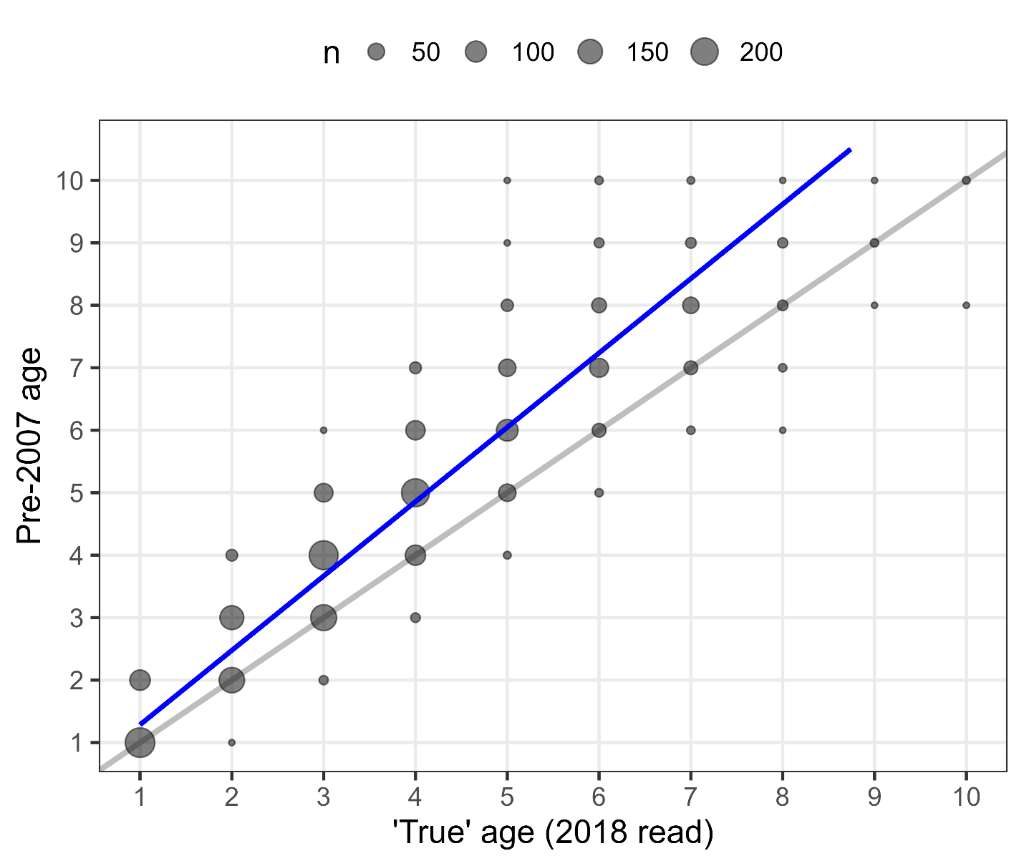
Data updates: ageing bias
Used re-read data in 2018 to estimate ageing bias parameters pre-2007 with AgeingError R-package
Propose: Fix ageing bias parameters (rather than estimated) based on re-read data at 0.24 for age-1 and 2.00 for age-10 with linear bias between

Slide 16
Model: updating ageing error & bias
Decreases overall negative log-likelihood (CAAL)
Slight increase in mean recruitment, increase in trawl survey catchability
Component | 2019.1b | 2019.1c | 2019.1d
TOTAL | 3050.99 | 2805.81 | 2727.26
Catch | 1.21E-12 | 5.98E-12 | 3.99E-12
Survey | -3.78 | -6.80 | -8.03
Length_comp | 1868.43 | 1704.53 | 1697.31
Age_comp | 1180.16 | 1100.23 | 1030.48
Recruitment | -4.86 | -2.55 | -2.96
InitEQ_Regime | 3.10 | 3.16 | 3.25
Forecast_Recruitment | 0.41 | -- | --
Parm_priors | 1.02 | 1.14 | 1.15
Parm_softbounds | 0.01 | 0.01 | 0.01
Parm_devs | 6.50 | 6.08 | 6.04
Parameter | 2019.1b | 2019.1c | 2019.1d
NatM | 0.46 | 0.47 | 0.48
NatM: 14-16 | 0.80 | 0.82 | 0.82
lnR | 12.87 | 12.99 | 13.03
q_twl | 1.07 | 1.19 | 1.23
q_ll | 1.06 | 1.08 | 1.11
q_llenv | 1.46 | 1.28 | 1.37

Slide 17
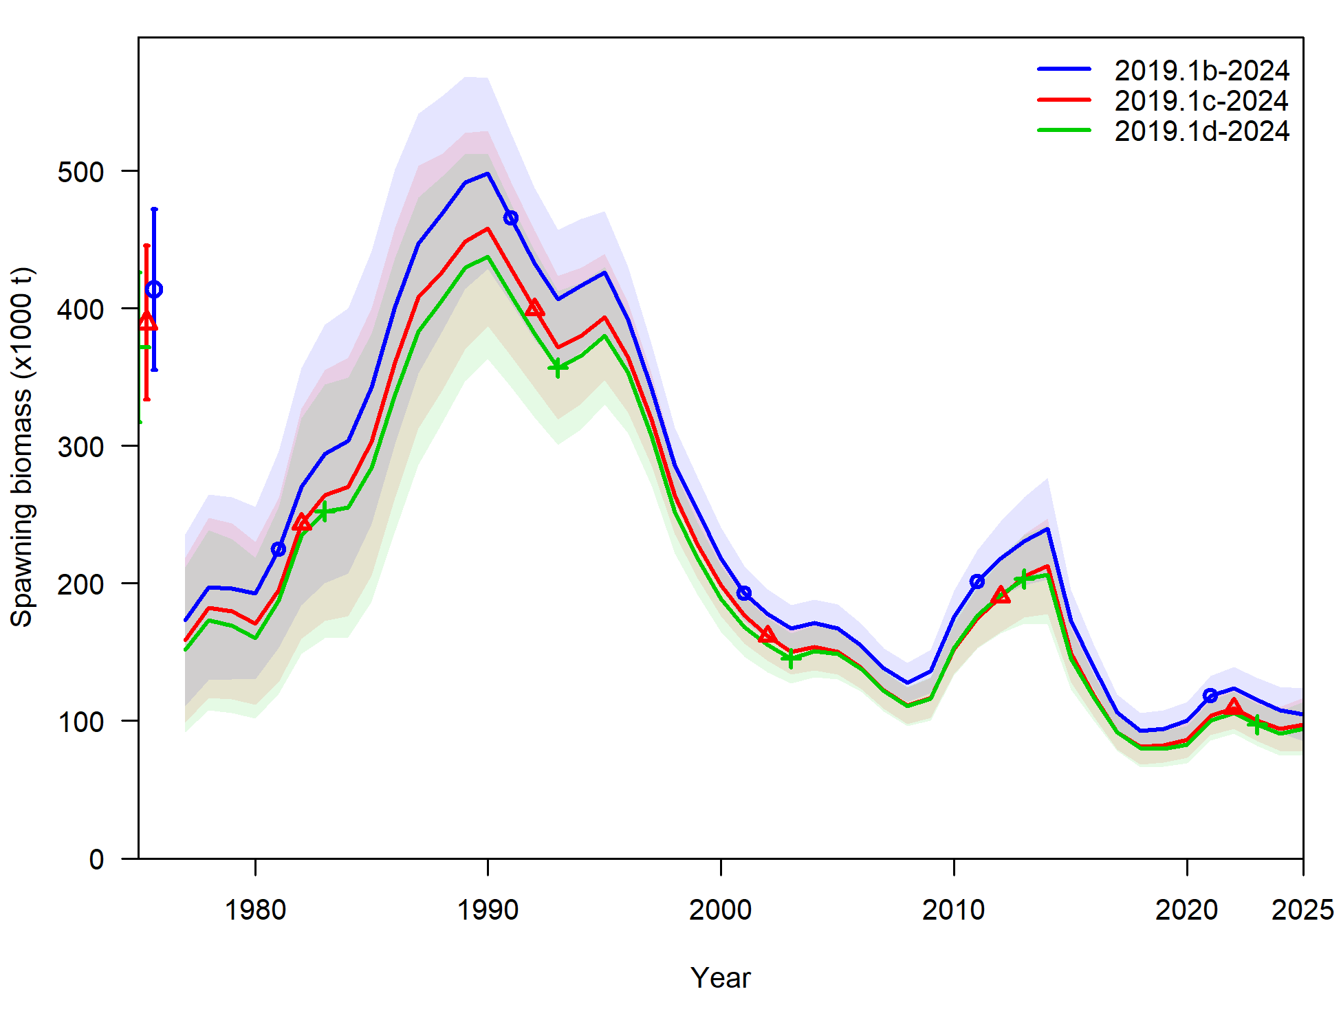
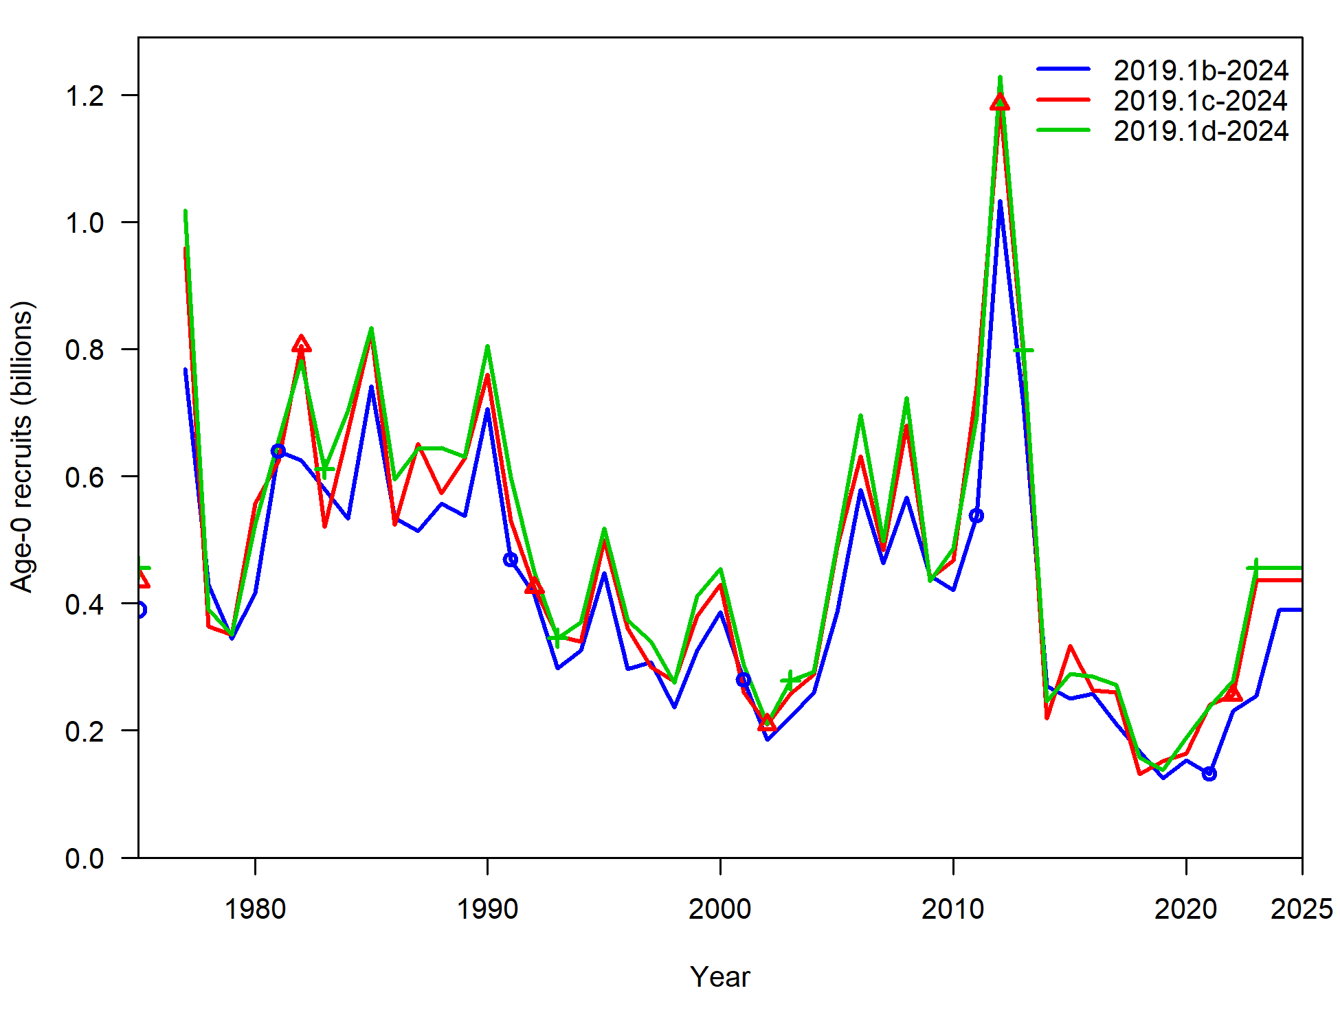
Model: updating ageing error & bias
Subtle changes to estimated SSB, smooths out some of the year-classes
Recommend updating ageing error & bias in model 2019.1d

Slide 18
Fishery length comp investigations
In process of code redevelopment, took time to evaluate how fishery length comps computed
Reminder: have been having issue with increasing variability in recent data, particularly Pot fishery length comps
First, will walk through how fishery length comps are computed
2 expansion methods used in GOA Pcod assessment:
Pre-1991 (includes foreign data)
Post-1991 (domestic data only)

Slide 19
Fishery length comp overview
Pre-1991:
Computes weighted length frequencies at haul level for foreign and domestic separately (weighted by extrapolated number in haul)
Sums across foreign and domestic weighted length frequencies at year-gear level, standardizes

Slide 20
Fishery length comp overview
Post-1991:
Computes weighted length frequency in a haul across area and gear within each week (weighted by extrapolated number in haul)
Sums weighted length frequency within hauls to week-area-gear level, weights by proportion of catch within each week-area-gear / catch by year-gear (catch in tons)
Sums to trimester-area-gear, fills in State data where there is no Federal data
Sums to year-gear, standardizes

Slide 21
Fishery length comp investigations: filtering
Post-91 data filtering: >10 per haul: proportion of hauls removed:
 | Longline | Pot | Trawl
1991-2012 | 2% | 4% | 3%
2013 | 12% | 12% | 2%
2014 | 6% | 14% | 5%
2015 | 5% | 8% | 4%
2016 | 13% | 10% | 4%
2017 | 12% | 12% | 20%
2018 | 23% | 6% | 6%
2019 | 22% | 10% | 6%
2020 | 60% | -- | 79%
2021 | 20% | 14% | 72%
2022 | 6% | 30% | 76%
2023 | 34% | 36% | 68%

Slide 22
Fishery length comp investigations: filtering
Post-91 data filtering: >10 per haul in fed data
Propose: remove filter and include all data
Why?
Increasing number of hauls that get filtered, don’t expect that to change any time soon
Increased variability in length comps with smaller number of fish sampled within a haul not a reason to remove data, would be expected and working on methods to be able to capture/quantify that variability
Given stock status, need as much data as we can get to understand demographics of fish captured in fishery

Slide 23
Fishery length comp investigations: State data
State data used to ‘fill-in’ missing federal observer data:
2 steps:
Step 1: filters state data to more than 30 lengths observed (at trimester-area-gear level) – very few filtered out, most for 90s trawl data
Step 2: uses state data if fed data missing for that trimester-area-gear combo
% data used | Longline | Pot | Trawl
1997-2016 | 35% | 19% | 38%
2017 | 33% | 0% | --
2018 | 40% | 33% | --
2019 | 40% | 50% | --
2020 | 100% | 100% | --
2021 | 67% | 67% | --
2022 | 60% | 0% | --
2023 | 50% | 100% | --

Slide 24
Fishery length comp investigations: State data
Propose: rather than ‘fill-in’, merge with fed data
Why?
State fishery landings are included within total catch removals fit within assessment model – would want estimated selectivity to be fit to composition data that is reflective of the removal data
Hasn’t been used: (1) because wasn’t really needed given magnitude of federal data, and (2) because it resulted in differences with federal data
Increased variability in length comps because of difference in length comp across fleets/sectors not a reason to not use data, would be expected (working on methods to be able to capture/quantify that variability)
Given stock status, need as much data as we can get to understand demographics of fish captured in fishery

Slide 25
Fishery length comp investigations
Current method to expand fishery length comps complex and granular
Propose: simplify and expand from month-area-gear level rather than week-area-gear
Why?
To merge State data, requires restructure of how fed length comp data computed: week-area-gear level of granularity not available in state data
Granularity due to account for cod growth throughout year, month vs week can still account for that
Quantity of data in recent years may not support this level of expansion

Slide 26
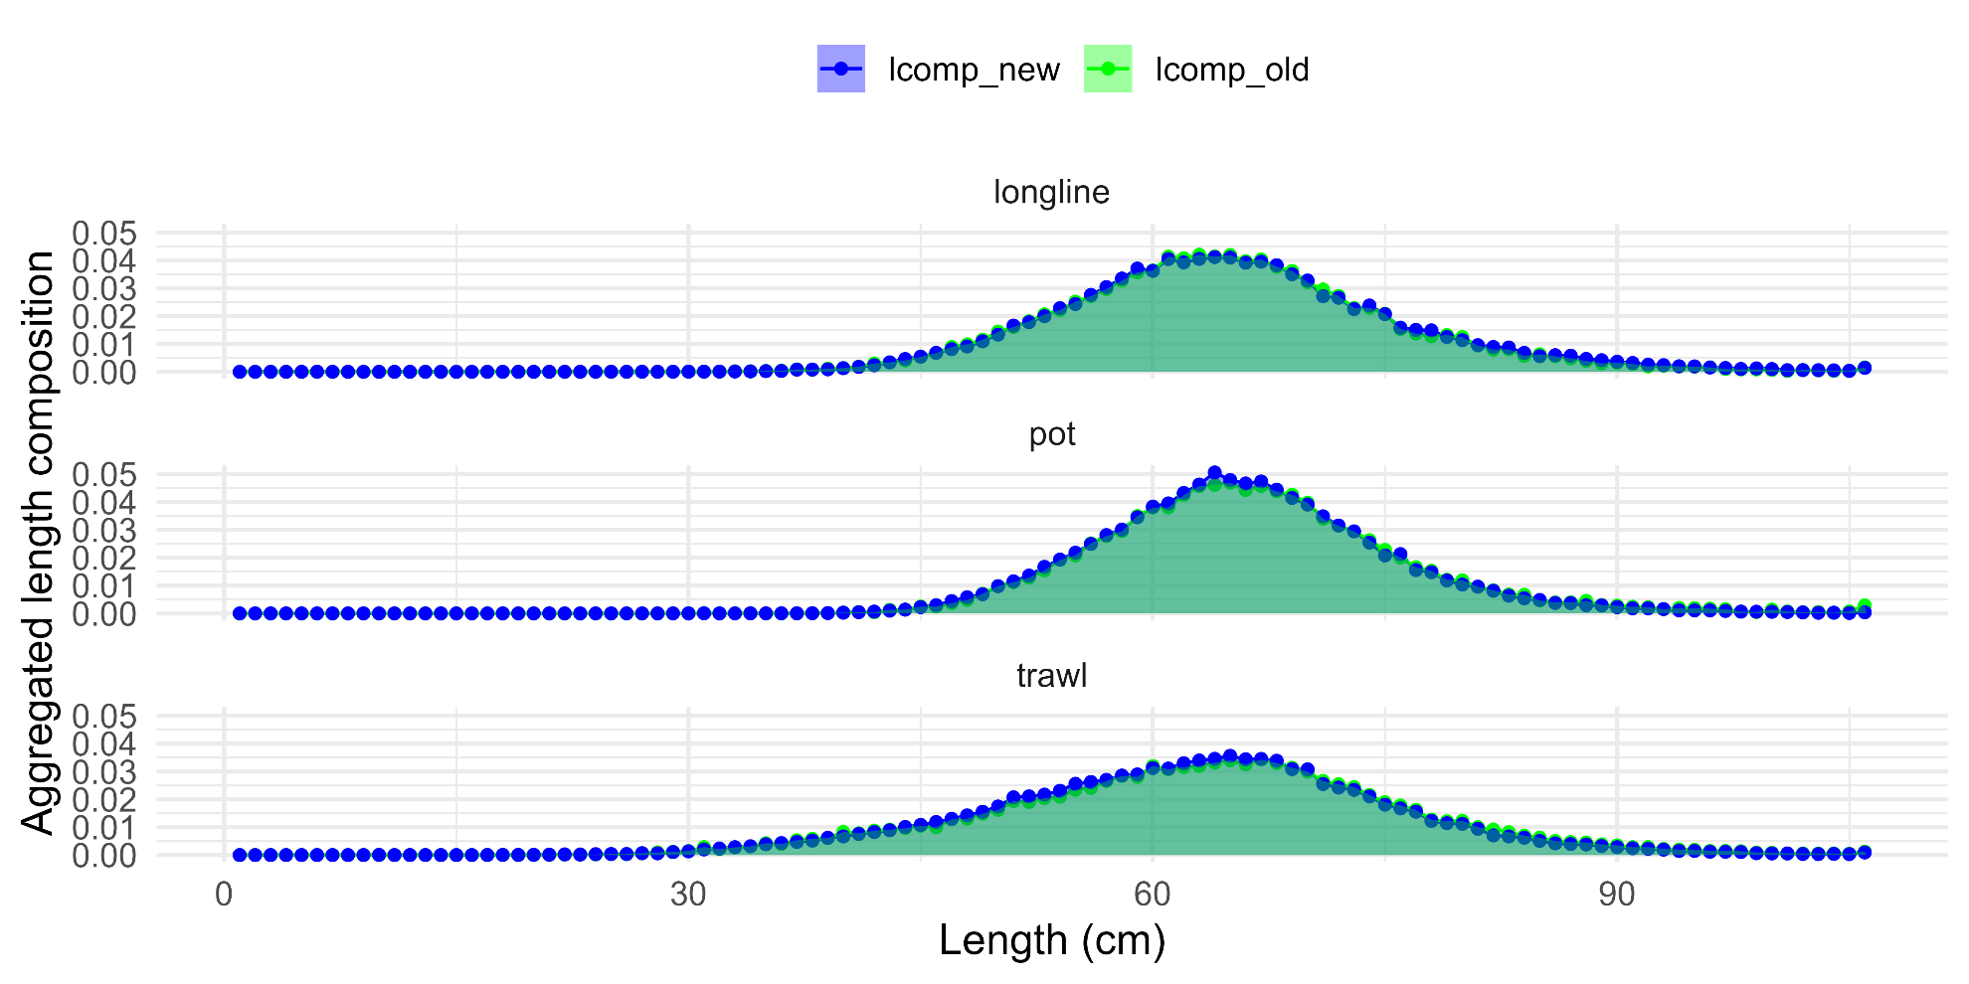
Fishery length comp investigations
Aggregated length comps: some subtle differences, but overall not that different

Slide 27
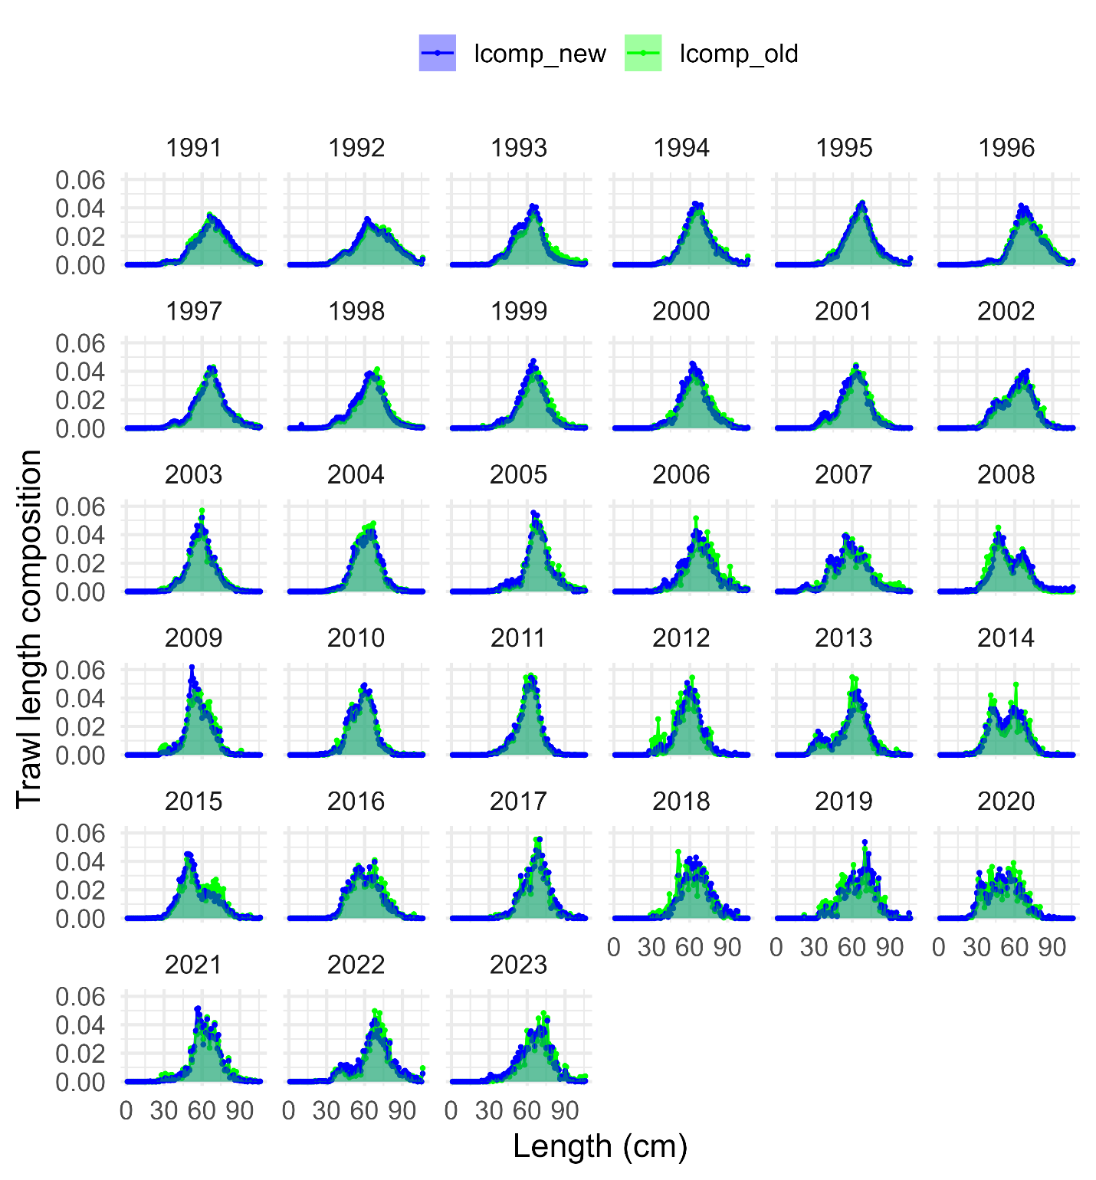
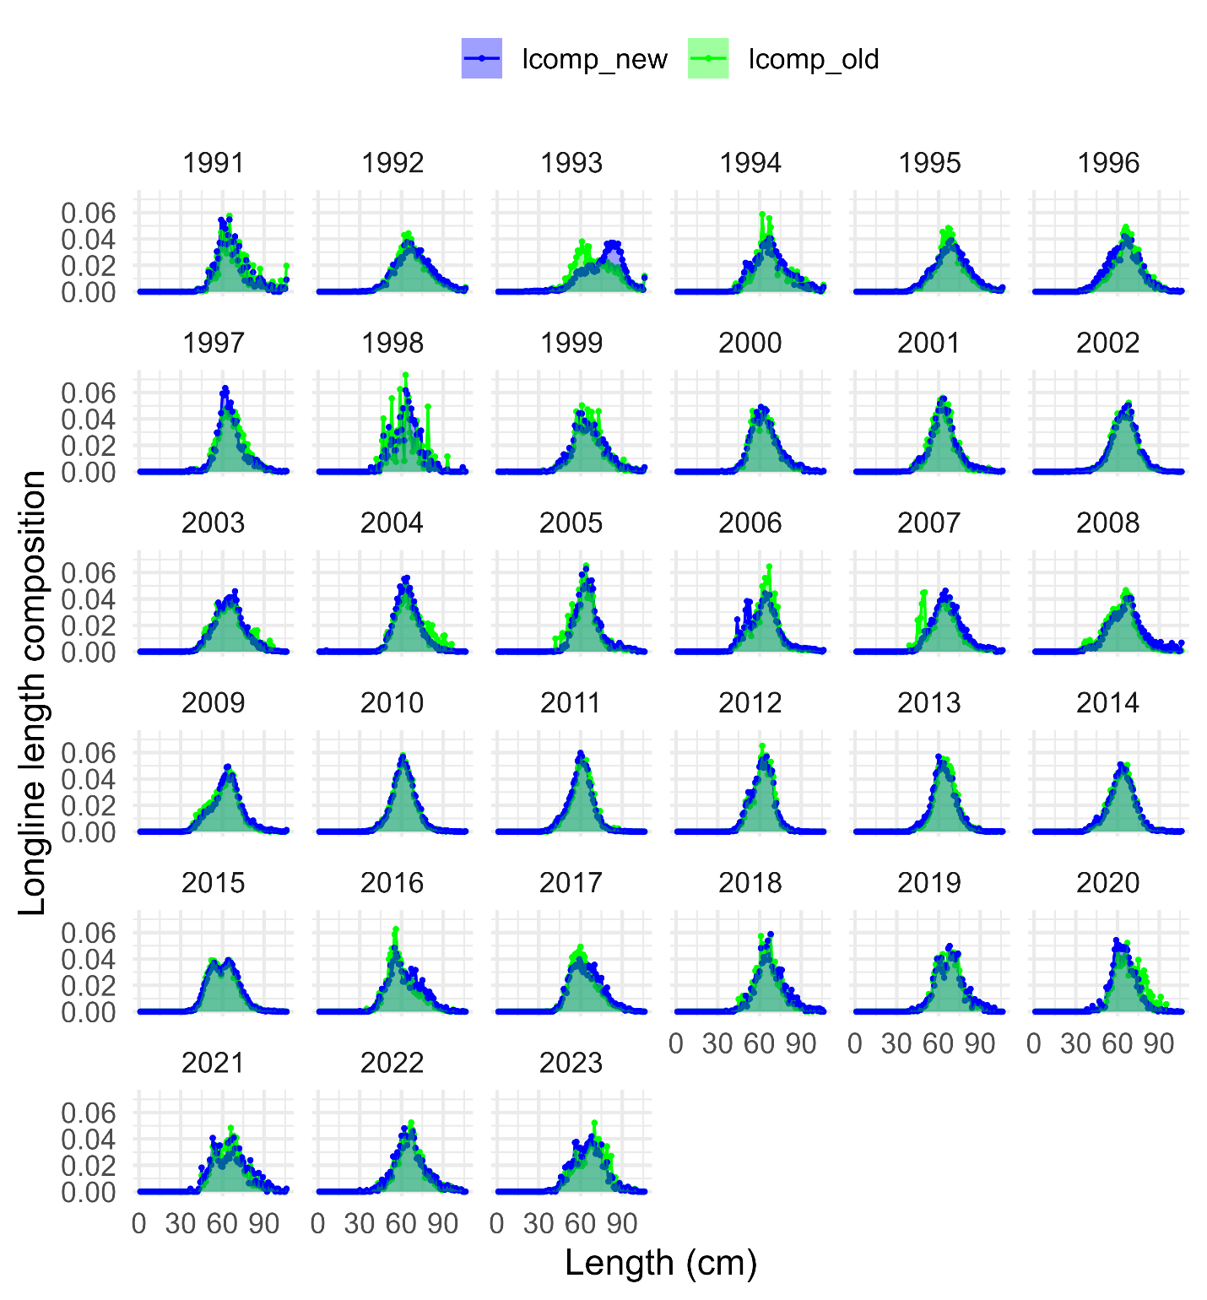

Slide 28
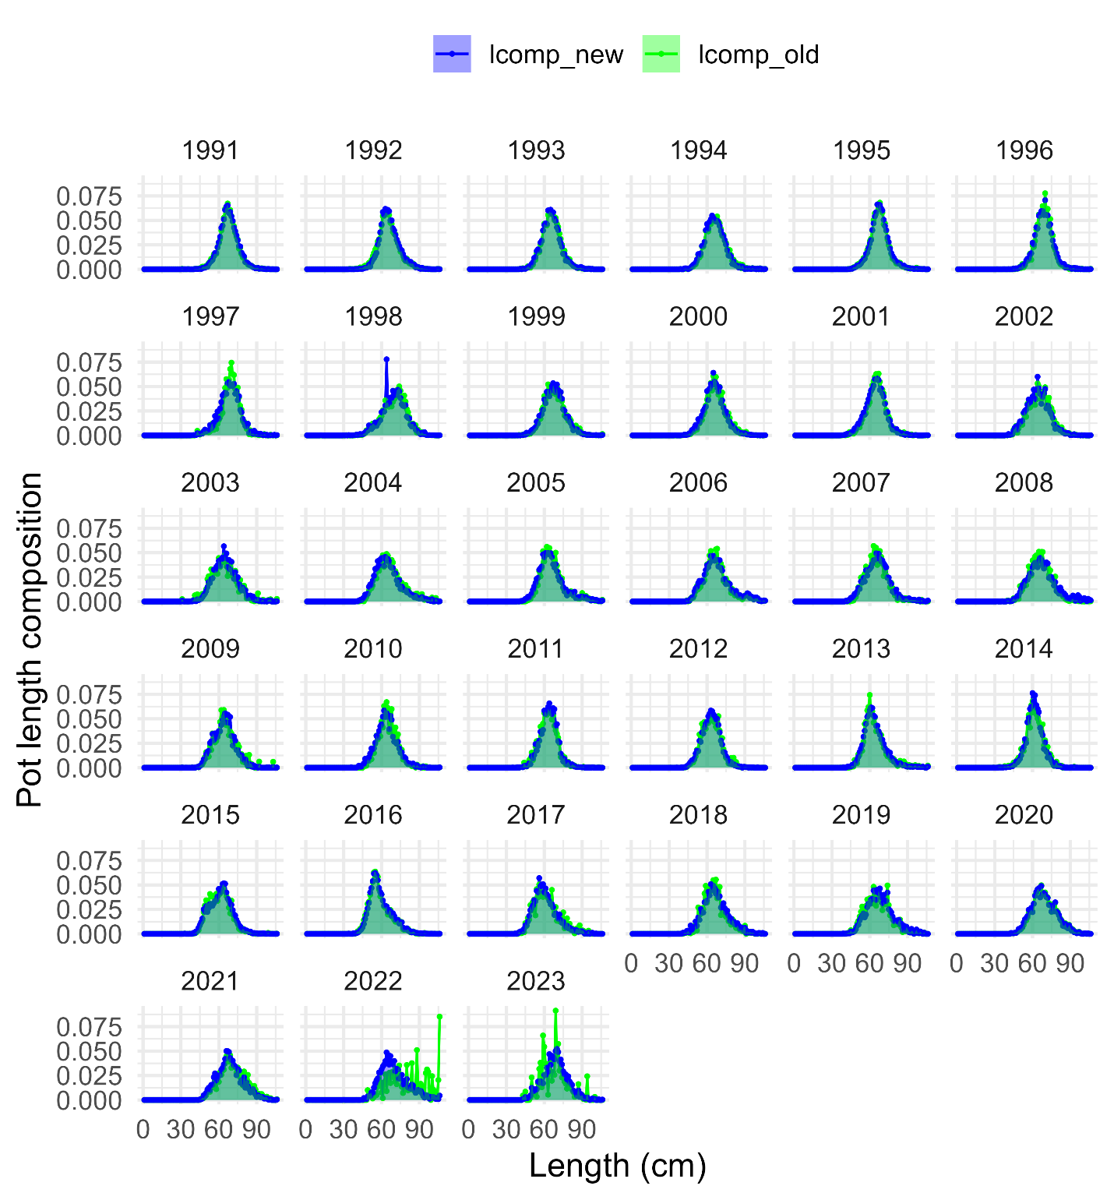

Slide 29
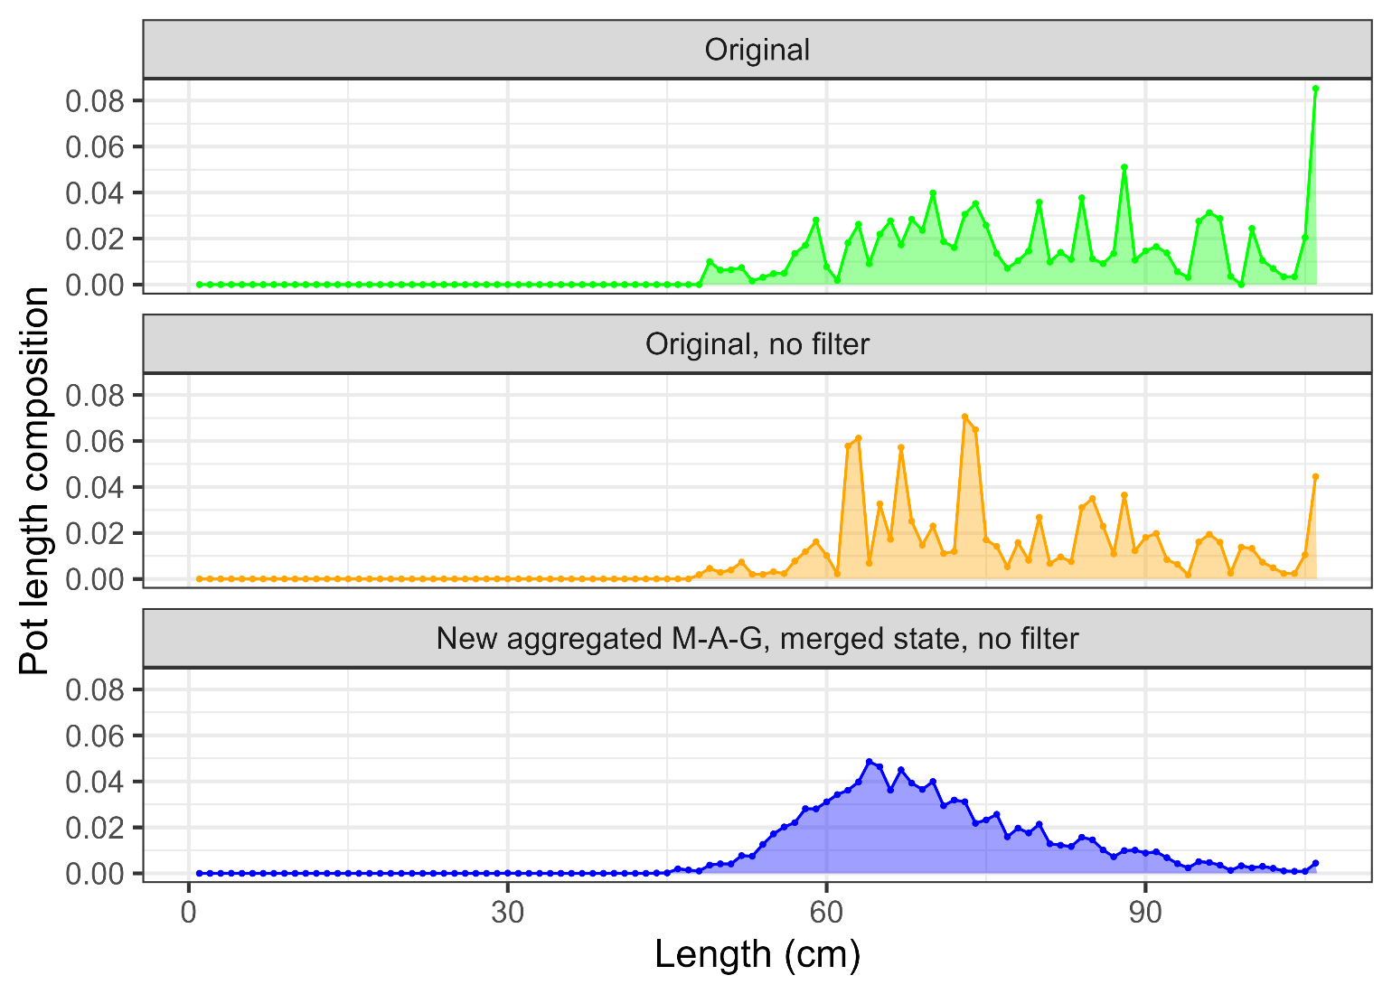
37 hauls
n = 698
No state
53 hauls
n = 794
No state
n = 6417
With state

Slide 30
Fishery length comp investigations
In general, removing filters, aggregating at month-area-gear level and merging state data helps to smooth out much of the variability in fishery length comps, particularly in recent years
Provides a simpler method and leverages all sources of available data to inform model estimates
In order to remove variability in fishery length comps and leverage information contained within State length sampling data, Recommend new fishery length composition in model 2019.1e

Slide 31
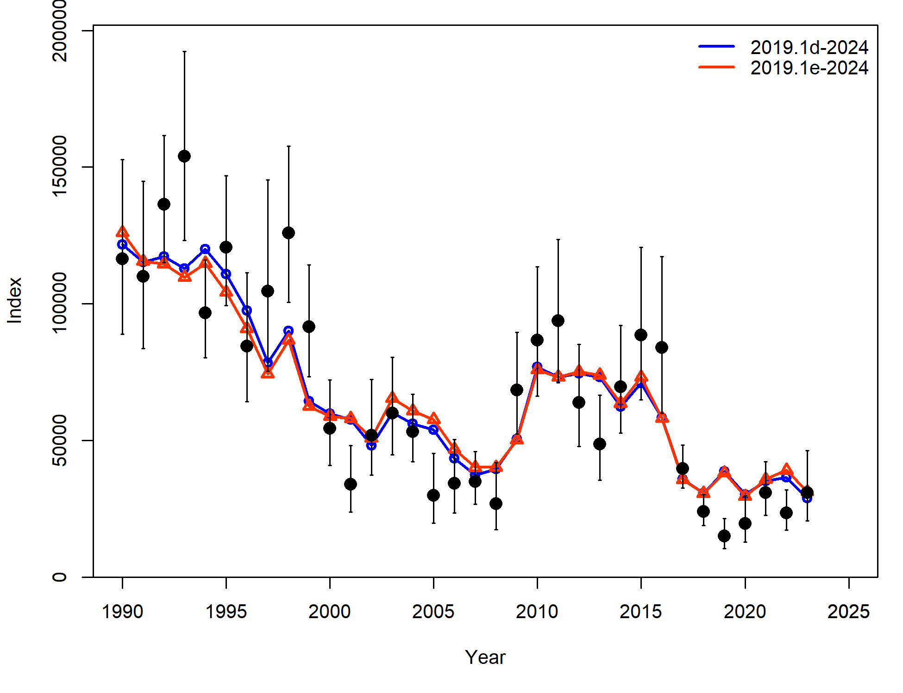
Fishery length comp investigations
Increase in negative log-likelihood value for surveys (due to longline survey fit), decrease for length comps
 | 2019.1d | 2019.1e
ALL | -8.03 | 0.63
Srv | -7.19 | -5.23
LLSrv | -0.84 | 5.86
Component | 2019.1d | 2019.1e
TOTAL | 2727.26 | 2715.80
Catch | 3.99E-12 | 2.44E-12
Survey | -8.03 | 0.63
Length_comp | 1697.31 | 1676.90
Age_comp | 1030.48 | 1030.97
Recruitment | -2.96 | -3.03
InitEQ_Regime | 3.25 | 3.17
Parm_priors | 1.15 | 1.16
Parm_softbounds | 0.01 | 0.01
Parm_devs | 6.04 | 6.00

Slide 32
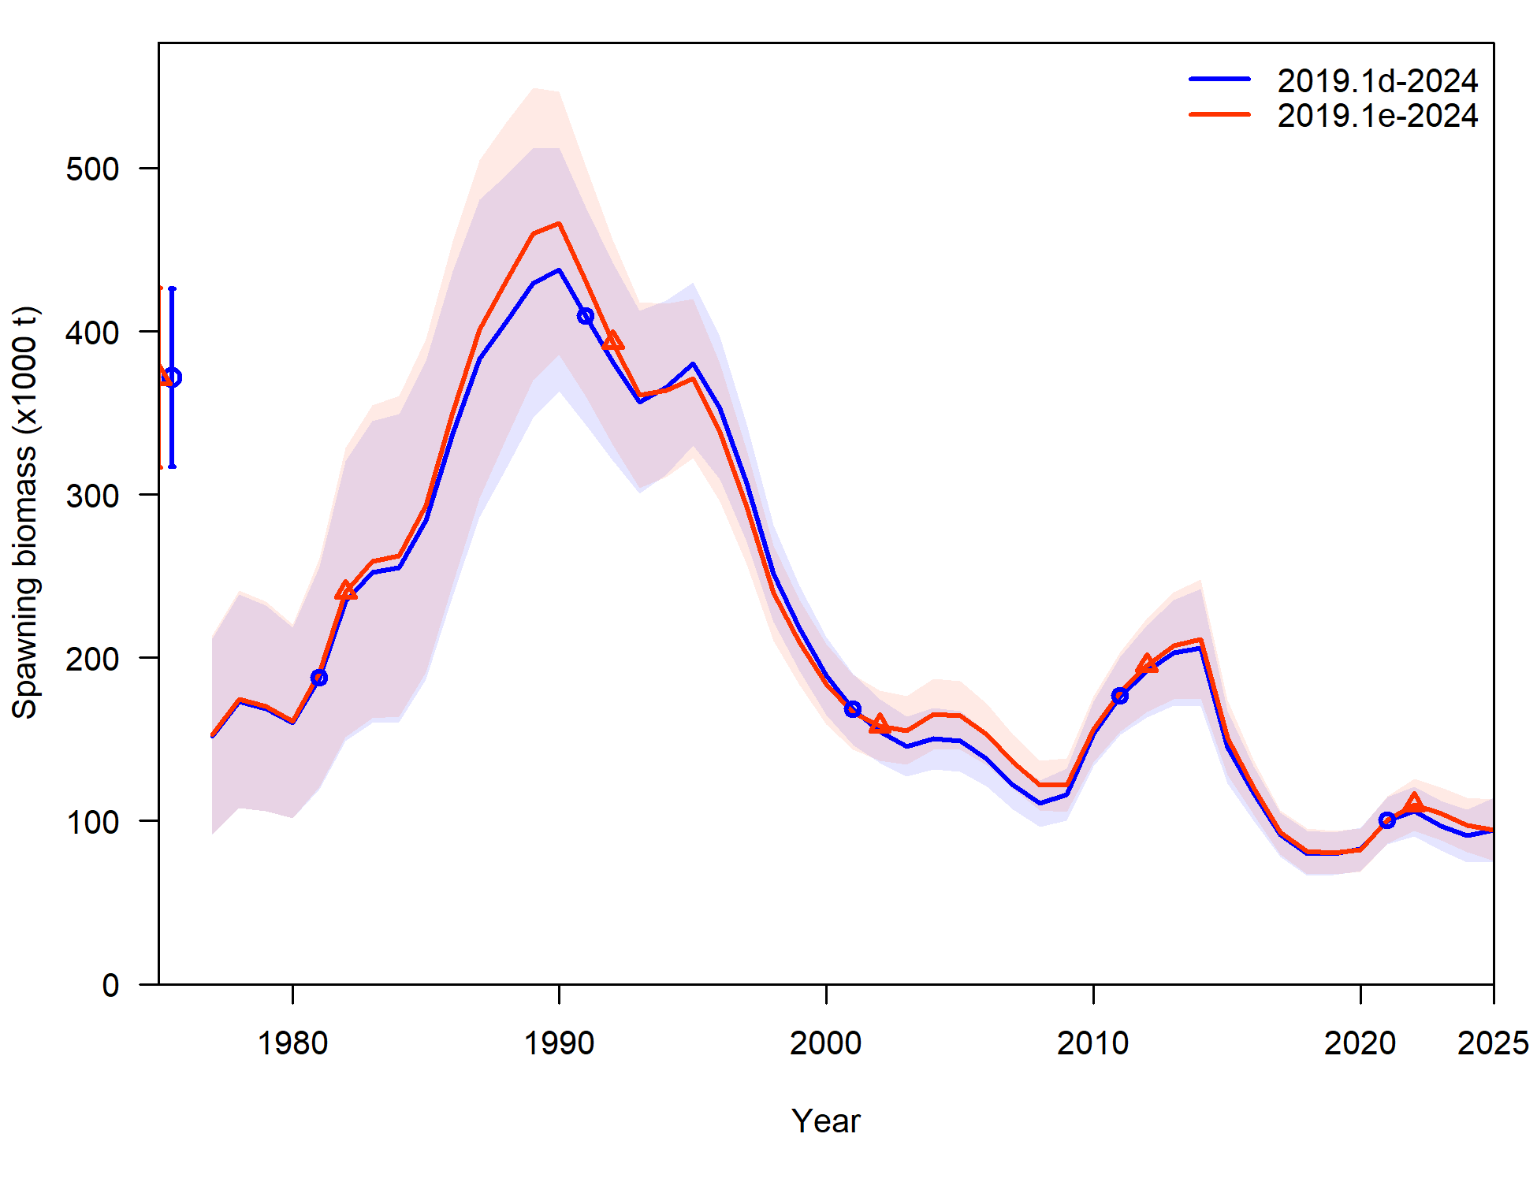
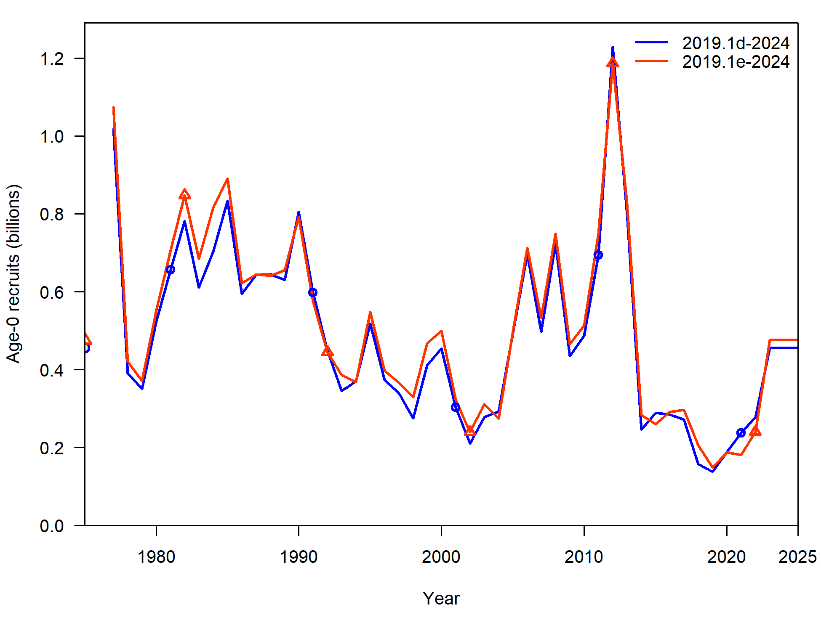
Fishery length comp investigations
Not a dramatic change in SSB or recruitment estimate trends, though differences in some years

Slide 33
Length composition binning
But, only gets us so far, there remains variability across lengths in length composition data in general with 1 cm length bins
Align with EBS cod investigations this year, and investigate binning length data
2 cm bins – 2019.1e.2cm
5 cm bins – 2019.1e.5cm
Affects: all length composition and CAAL for surveys and fishery fleets

Slide 34
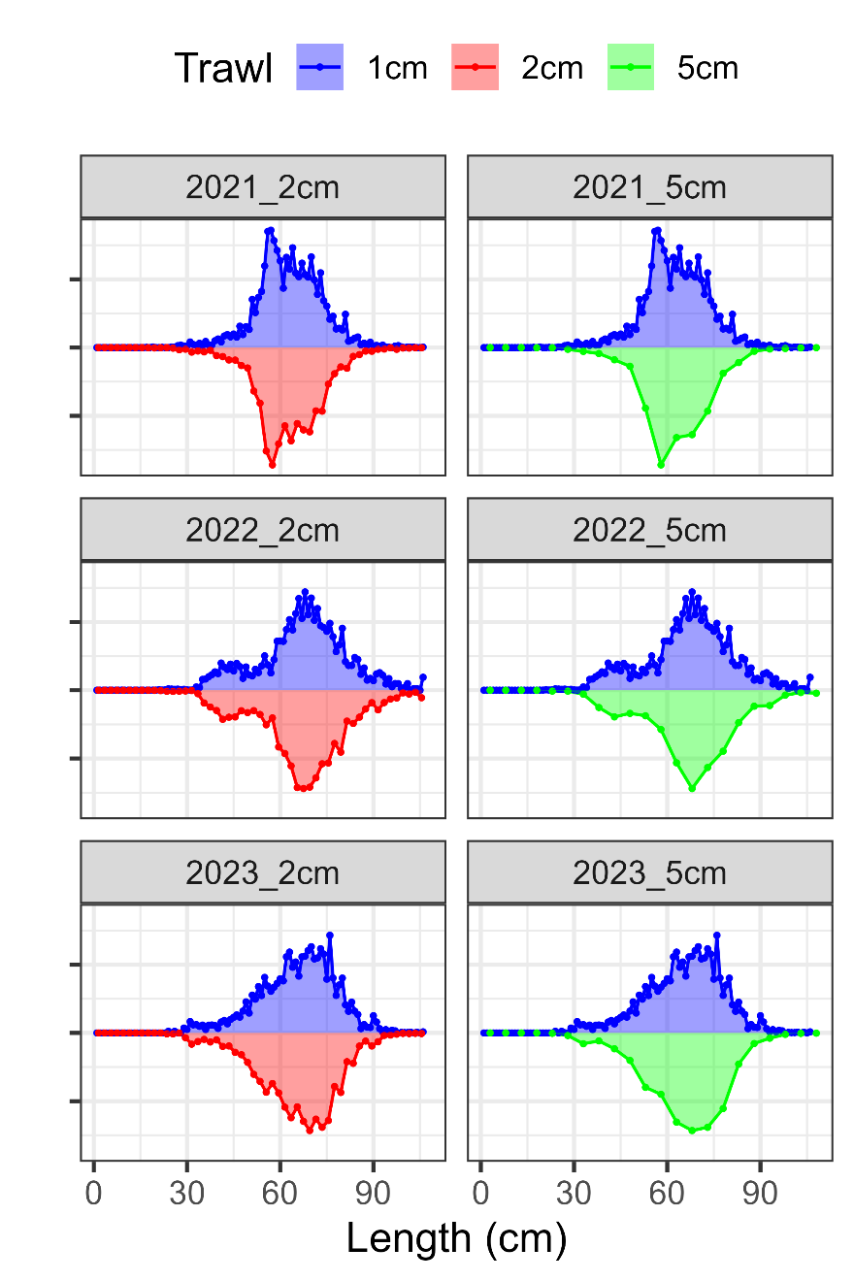
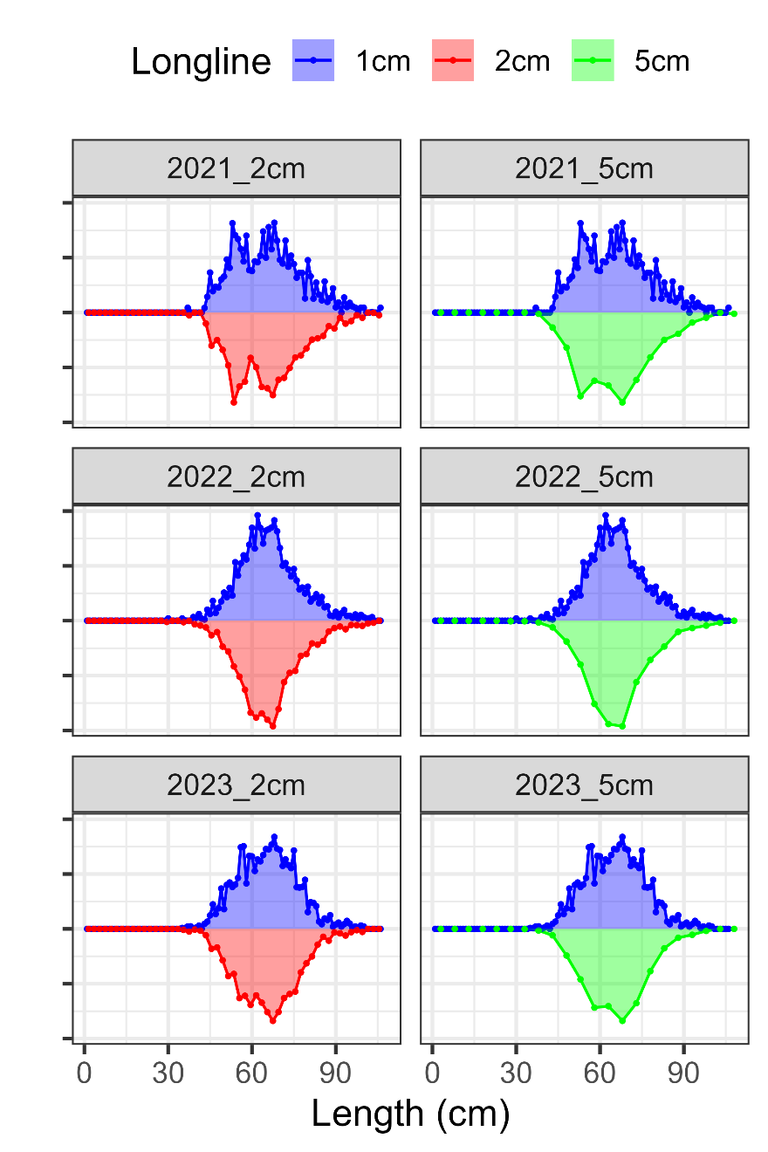
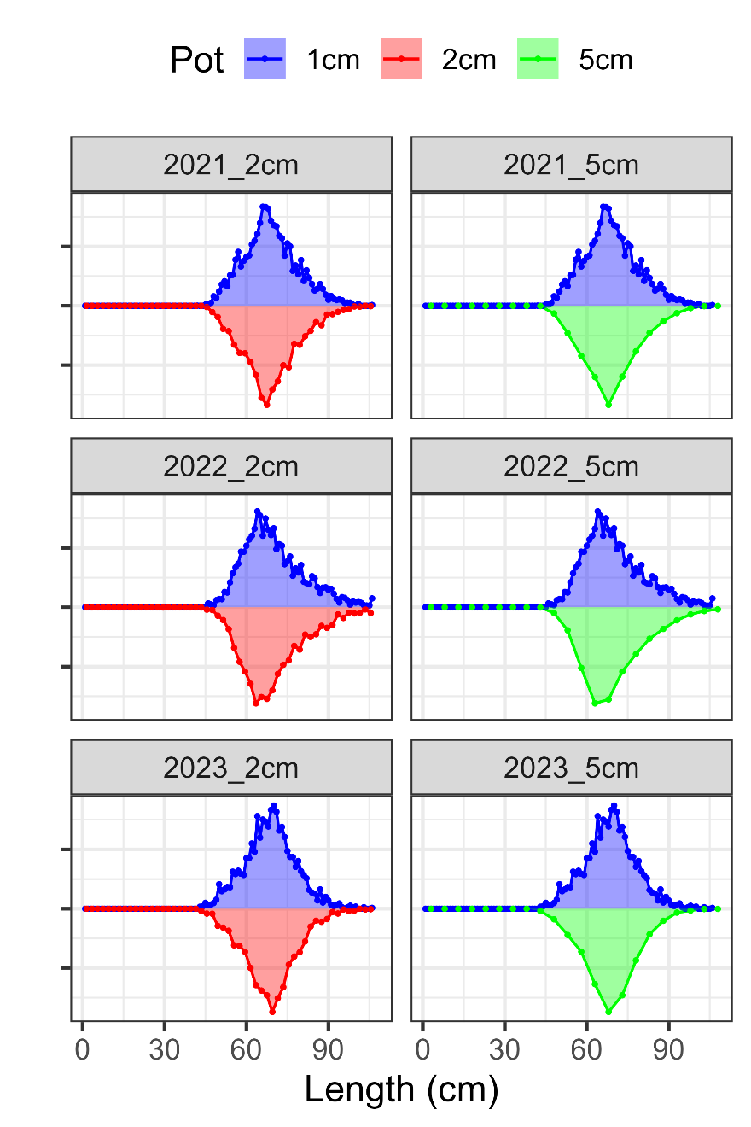
Length comp binning: fishery

Slide 35
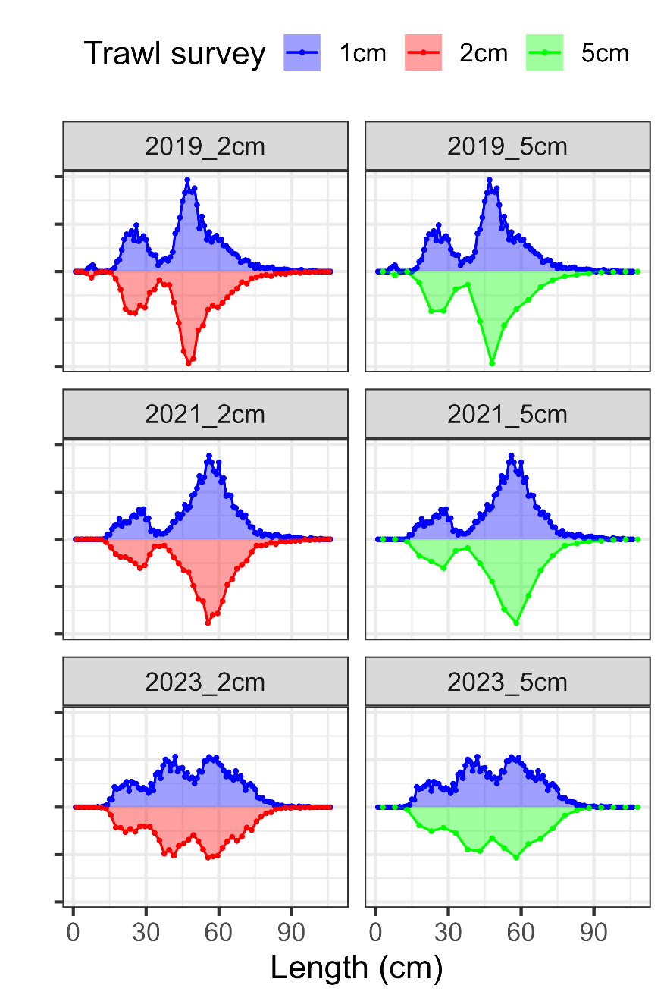
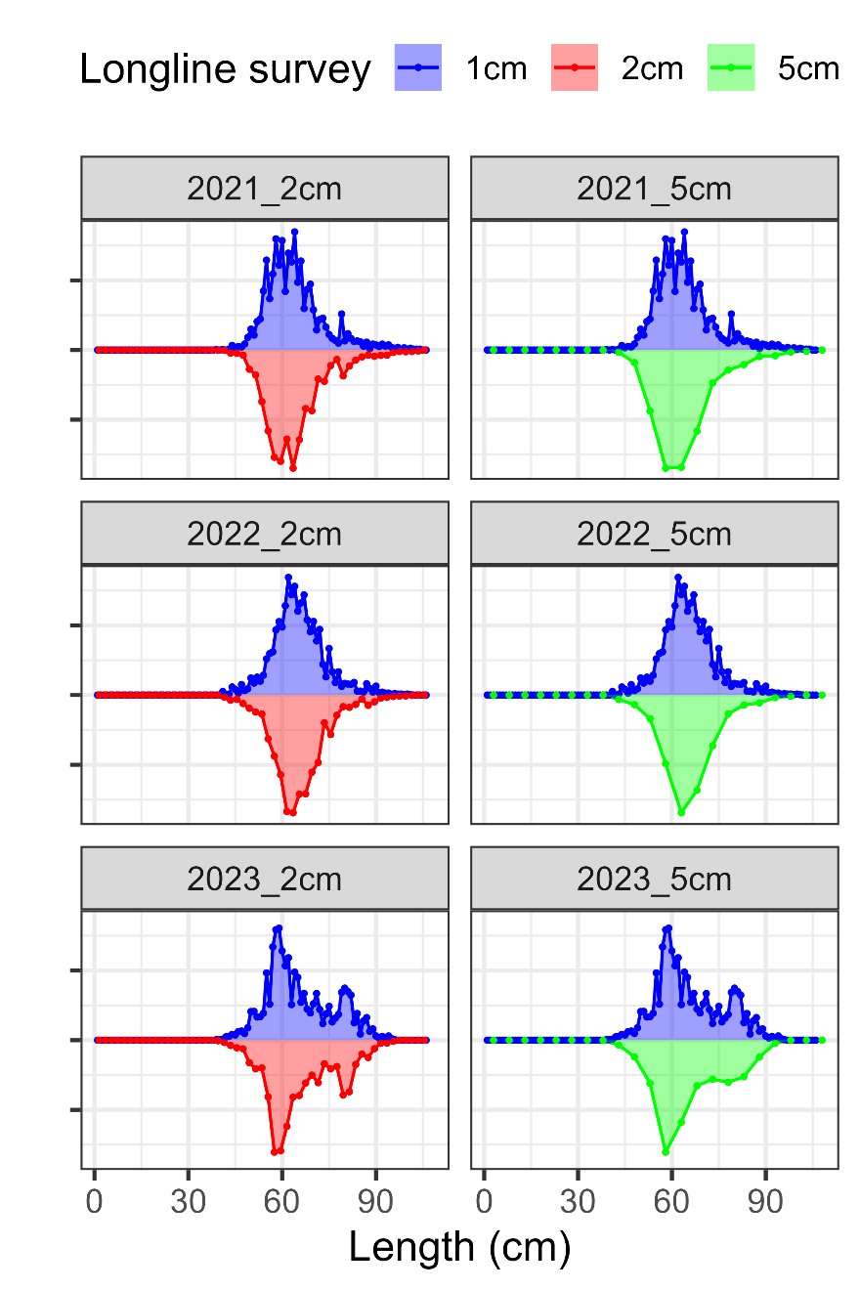
Length comp binning: survey

Slide 36
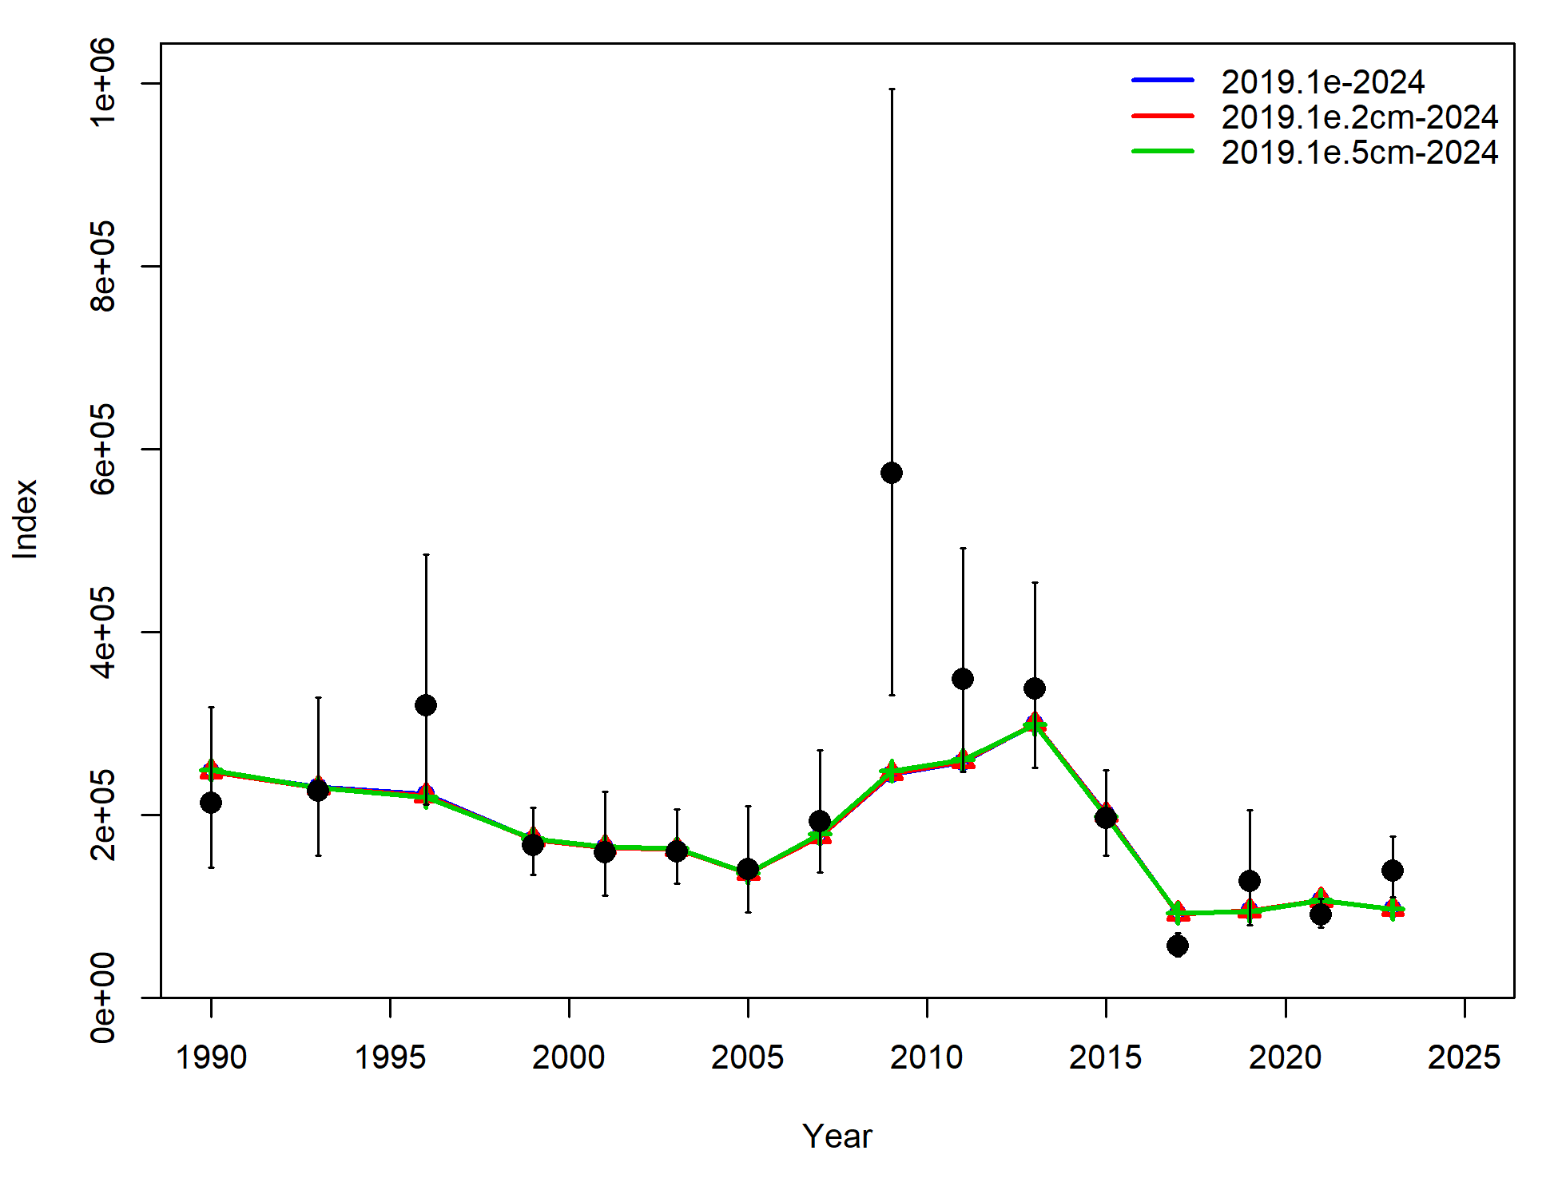
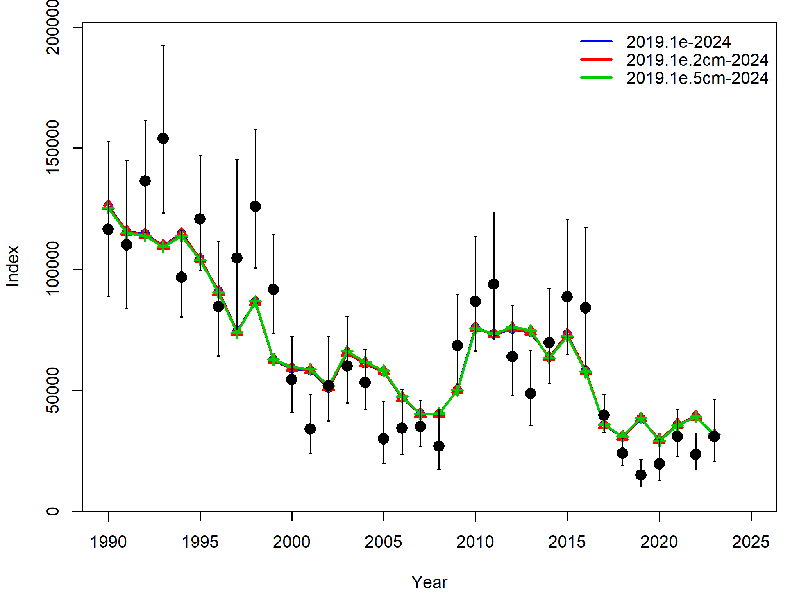
Length comp binning
Data fits:
Component | 2019.1e | 2019.1e.2cm | 2019.1e.5cm
TOTAL | 2715.80 | 2342.31 | 1974.01
Catch | 2.44E-12 | 1.98E-12 | 1.91E-12
Survey | 0.63 | 1.46 | 2.16
Length_comp | 1676.90 | 1507.59 | 1330.40
Age_comp | 1030.97 | 825.75 | 633.31
Recruitment | -3.03 | -2.74 | -1.62
InitEQ_Regime | 3.17 | 3.18 | 3.02
Parm_priors | 1.16 | 1.13 | 1.08
Parm_softbounds | 0.01 | 0.01 | 0.01
Parm_devs | 6.00 | 5.92 | 5.65

Slide 37
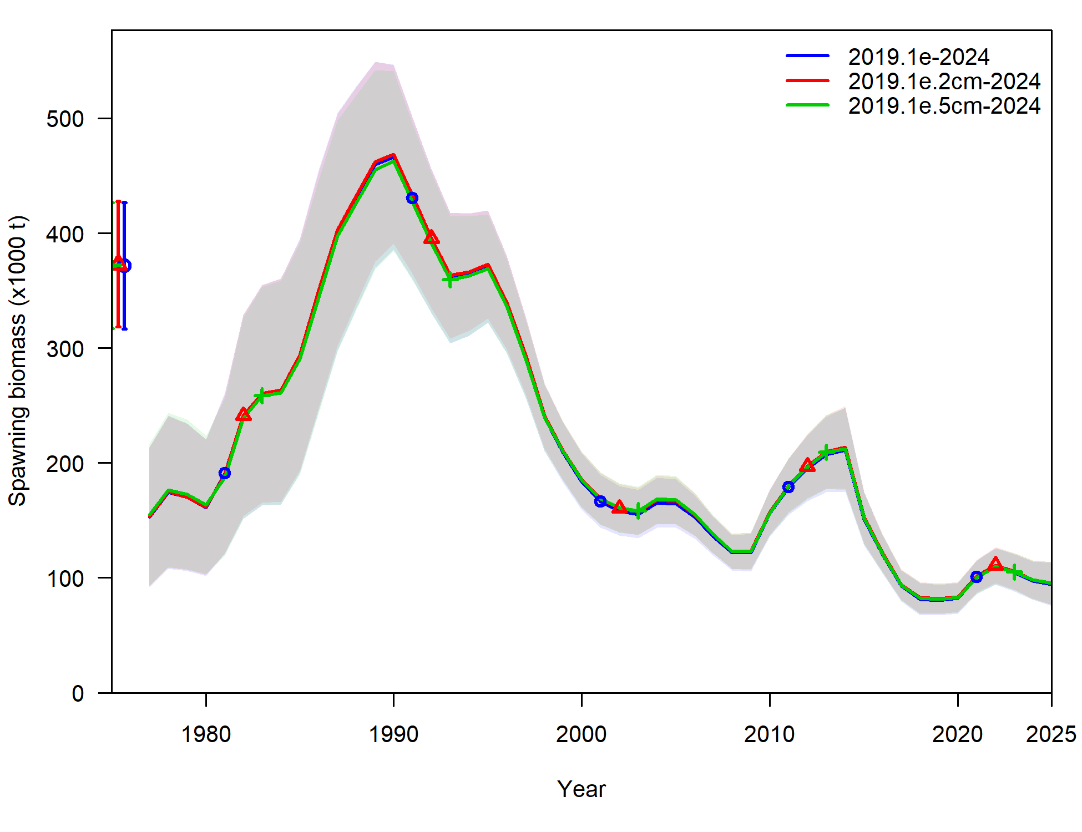
Length comp binning
No significant changes in model estimates duet to length comp binning
Provides a more efficient model, reduces run time by >50%
Recommend: model 2019.1e.5cm

Slide 38
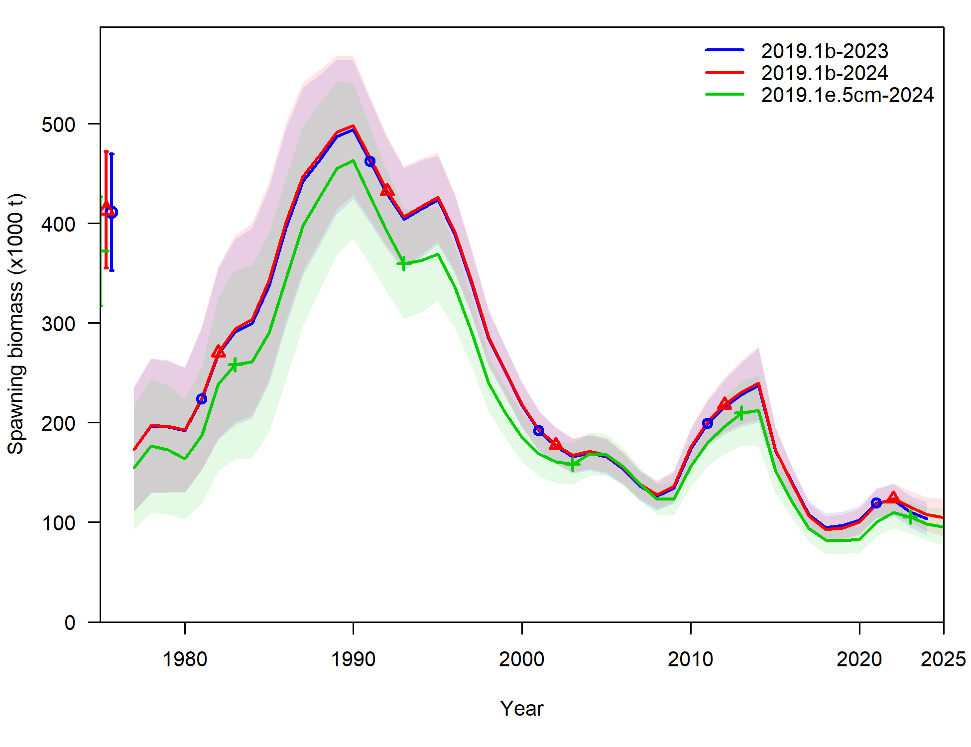
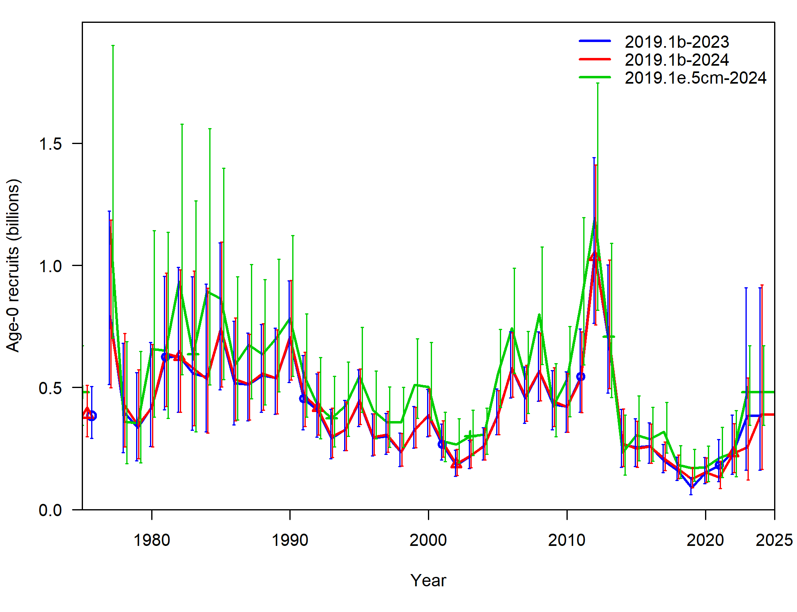
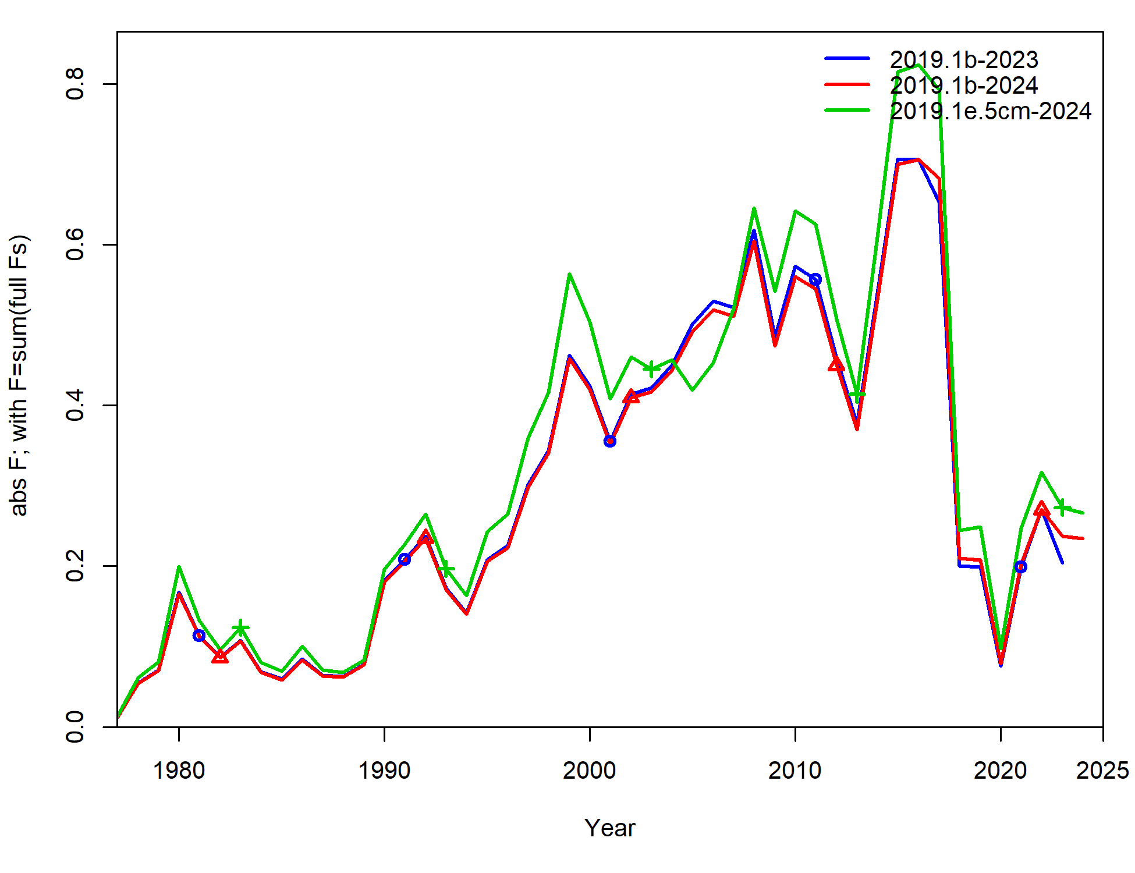
Recommended model 2019.1e.5cm vs base
Shift to smaller values in SSB, coupled with larger recruitment and F

Slide 39
Recommended model 2019.1e.5cm vs base
Largest parameter change in survey catchability (but has been as high as 1.46 in 2017 assessment, and was 1.23 after 2019.1d, 1.19 after 2019.1c)
Parameter | 2019.1b-23 | 2019.1b-24 | 2019.1e.5cm
NatM | 0.46 | 0.46 | 0.48
NatM: 14-16 | 0.79 | 0.80 | 0.80
lnR | 12.86 | 12.87 | 13.08
q_twl | 1.08 | 1.07 | 1.19
q_ll | 1.06 | 1.06 | 1.08
q_llenv | 1.42 | 1.46 | 1.28

Slide 40
Summary of significant assessment changes
Largest single change that caused shift in model estimates: season for trawl survey CAAL, 2nd = longline survey length comp rebinning
Updating ageing error & bias improves fit to age data (and length comps to some extent)
Simplifying fishery length comp expansion and merging State data helps to reduce variability in data
Binning at 5 cm makes model much more efficient

Slide 41
Summary of significant model changes
Recommend new model 2019.1e.5cm
To increase model naming efficiency, Recommend new model 2019.1e.5cm be renamed as model 2024
While the model’s formulation is the same as in the accepted 2019 model, significant differences exist in data inputs at this point

Slide 42
November models
New data that will be available:
Updated catch, fishery length comps
2023 Trawl survey CAAL
2023 Fishery CAAL
Models to present in November
Do I need to present all the c-series models? Or is just saying x, y, and z caused biggest effect good enough?
Present building upon 2019.1c with d and e, along with length binning?
Ideas for streamlining?

Slide 43
SSC/PT comments
Several SSC/PT comments were investigated that are worthy enough to get on record now, rather than in November
Apportionment with AFSC longline survey
Selectivity
Maturity update

Slide 44
Apportionment investigation
The SSC reiterates its encouragement for the authors to consider whether information from the IPHC setline survey and NMFS longline survey, alongside the NMFS bottom trawl survey, may provide a superior basis for apportionment recommendations, perhaps through the use of an integrated spatiotemporal model or a multi-survey random effects model.

Slide 45
Apportionment investigation
The SSC reiterates its encouragement for the authors to consider whether information from the IPHC setline survey and NMFS longline survey, alongside the NMFS bottom trawl survey, may provide a superior basis for apportionment recommendations, perhaps through the use of an integrated spatiotemporal model or a multi-survey random effects model.

Slide 46
Apportionment investigation
Here, look at including LLS into REMA as an additional index to be used for apportionment
Step-wise approach:
First, look at AIC ‘preferred’ model when it comes to Process Error (PE) and index scaling (q) parameters
Next, with ‘preferred’ models investigate estimating additional observation error

Slide 47
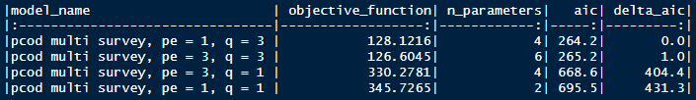
Apportionment investigation: Step 1
4 cases: factorial design of global (1) x regional (3) PE & q parameters
AIC suggests that regional scaling parameters q are supported (and most influential)
Whether PE = 1 or 3, no real difference in model

Slide 48
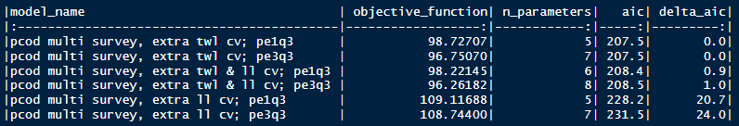
Apportionment investigation: Step 2
Factorial design of 2 PE:q cases from step 1 x 3 uncertainty cases (trawl only, longline only, trawl & longline)
Results in 4 models that are essentially the same, in terms of AIC

Slide 49
Apportionment investigation: Comparisons
Comparison of apportionment in 2023, and CV in apportionment over the most recent 5 years:
Incorporating LLS shifts 2023 apportionment from central by 1-3% to western/eastern
Incorporating LLS doubles to triples CV in apportionment
Model | western | w_cv | central | c_cv | eastern | e_cv
pcod trawl survey | 27% | 9% | 64% | 5% | 9% | 11%
pcod multi survey, extra ll cv; pe1q3 | 28% | 11% | 63% | 7% | 10% | 17%
pcod multi survey, extra twl cv; pe1q3 | 29% | 21% | 60% | 15% | 11% | 26%
pcod multi survey, extra twl & ll cv; pe1q3 | 29% | 15% | 60% | 11% | 11% | 23%
pcod multi survey, extra ll cv; pe3q3 | 27% | 11% | 63% | 7% | 10% | 19%

Slide 50
Apportionment investigation: Discussion
Recommend: wait to use REMA until:
Environmental link option developed in REMA – we hypothesize that the variability in apportionment that increases with the incorporation of the LLS may be reduced when environmental link used
Environmental link developed at sub-region scale
Working on environmental index, will be looking towards region indices to potentially be used in apportionment
Survey timing is slightly different in each region, whether/if this results in different environmental conditions by region remains to be seen

Slide 51
Apportionment investigation
The SSC reiterates its encouragement for the authors to consider whether information from the IPHC setline survey and NMFS longline survey, alongside the NMFS bottom trawl survey, may provide a superior basis for apportionment recommendations, perhaps through the use of an integrated spatiotemporal model or a multi-survey random effects model.

Slide 52
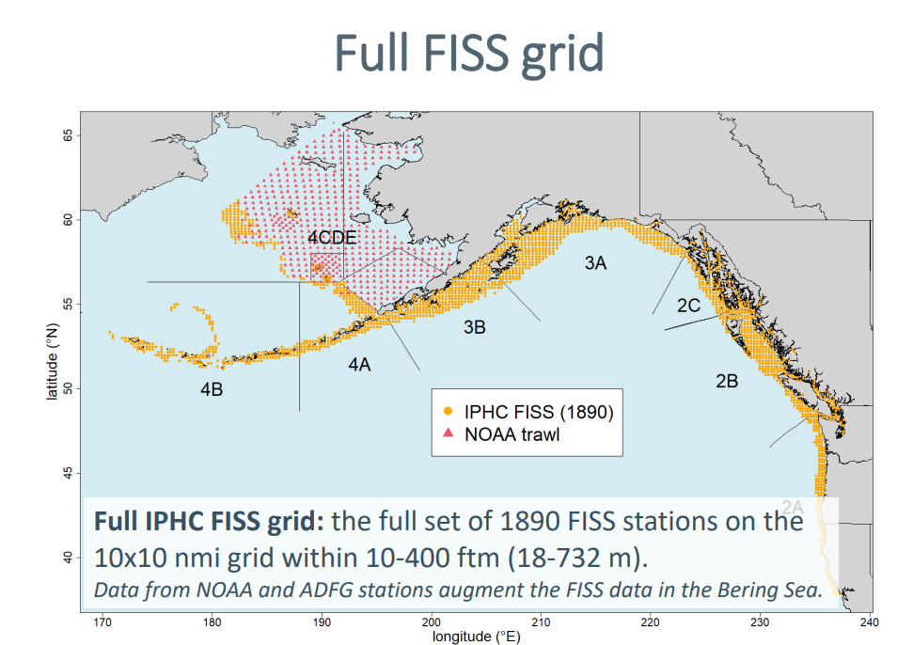
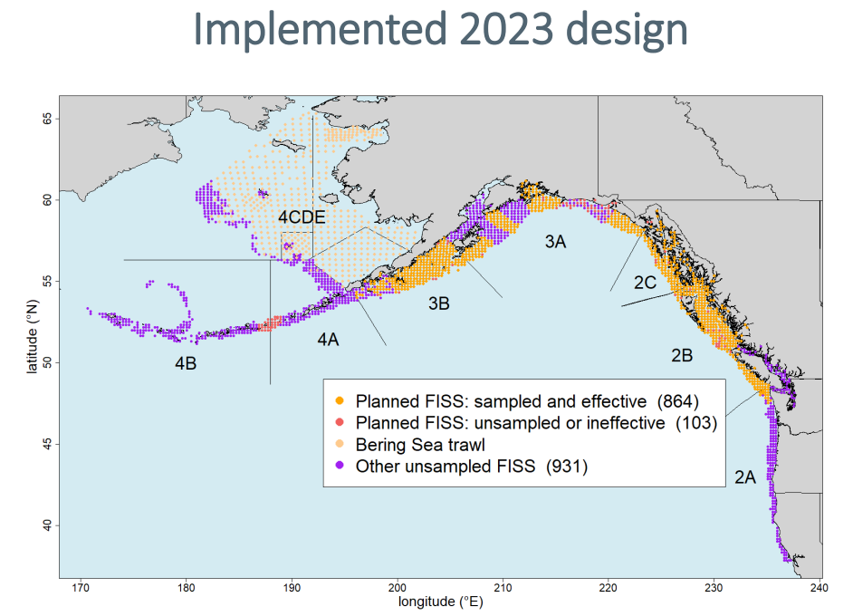
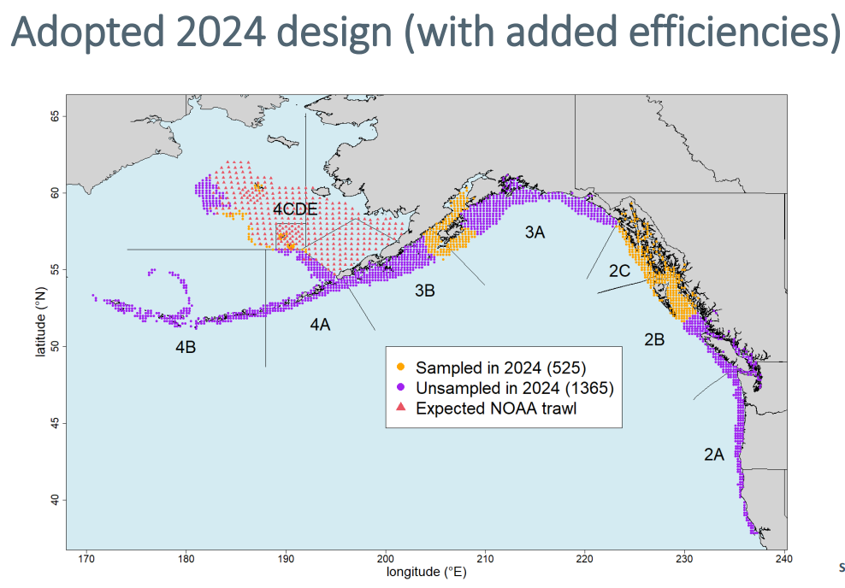
Apportionment investigation: Discussion
Other indices: IPHC FISS
Has always been a promising additional index for apportionment (and assessment), but…
Recommend: wait and see

Slide 53
Apportionment investigation
The SSC reiterates its encouragement for the authors to consider whether information from the IPHC setline survey and NMFS longline survey, alongside the NMFS bottom trawl survey, may provide a superior basis for apportionment recommendations, perhaps through the use of an integrated spatiotemporal model or a multi-survey random effects model.
Will continue to monitor progress in using VAST for apportionment and multi-survey integration

Slide 54
Trawl and longline survey selectivity
Estimated selectivity for both the bottom trawl survey and the longline survey showed patterns that seemed very unusual. For the bottom trawl survey, which modeled time-varying selectivity blocks, there was a shift from a strongly dome-shaped selectivity in the 1990-1995 time block to asymptotic selectivity in subsequent time blocks. The assessment did not provide a rationale for how a standardized survey could show such extreme changes in selectivity. For the longline survey, a strongly dome-shaped selectivity pattern was estimated for Pacific cod, in contrast to sablefish selectivity, which is estimated to be asymptotic for this survey in the sablefish assessment. In theory, the longline survey’s depth range would have selectivity issues for smaller fish at shallower depths, not larger deeper fish. Again, there is no explanation in the assessment as to why this selectivity pattern should be considered a reasonable result.

Slide 55
Trawl and longline survey selectivity
Estimated selectivity for both the bottom trawl survey and the longline survey showed patterns that seemed very unusual. For the bottom trawl survey, which modeled time-varying selectivity blocks, there was a shift from a strongly dome-shaped selectivity in the 1990-1995 time block to asymptotic selectivity in subsequent time blocks. The assessment did not provide a rationale for how a standardized survey could show such extreme changes in selectivity. For the longline survey, a strongly dome-shaped selectivity pattern was estimated for Pacific cod, in contrast to sablefish selectivity, which is estimated to be asymptotic for this survey in the sablefish assessment. In theory, the longline survey’s depth range would have selectivity issues for smaller fish at shallower depths, not larger deeper fish. Again, there is no explanation in the assessment as to why this selectivity pattern should be considered a reasonable result.

Slide 56
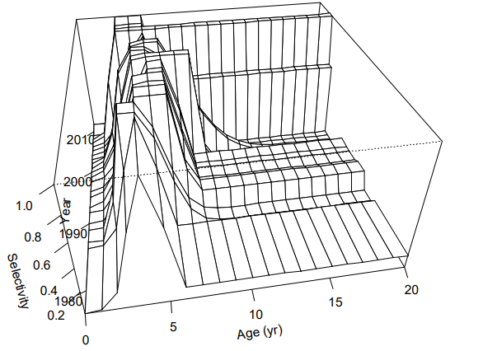
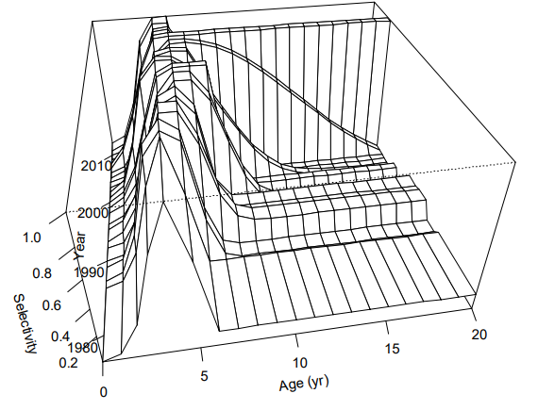
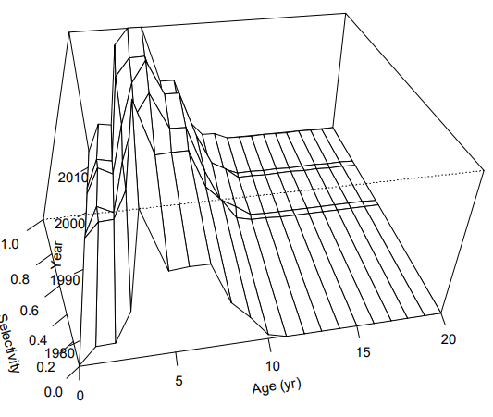
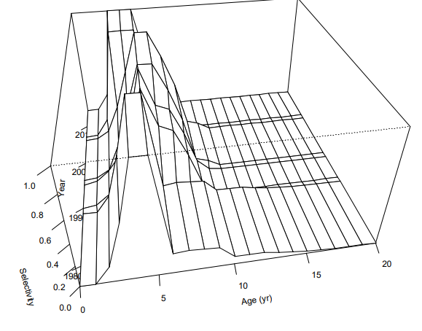
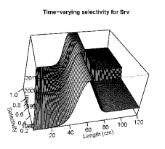
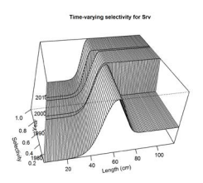
Trawl survey selectivity
The current time blocks used for the bottom trawl survey can be traced back to the 2014 approved model (reduced from 12 time-blocks)
Pre/post 96 block represents switch from 30 to 15 min tows
2016 approved model first set the current time blocks
Pre/post 2006 based on improvement in model fit (and switched to length)
The 2017 approved model switch from dome-shaped selectivity in recent time blocks to asymptotic based on lower AIC

Slide 57
Longline survey selectivity
Estimated selectivity for both the bottom trawl survey and the longline survey showed patterns that seemed very unusual. For the bottom trawl survey, which modeled time-varying selectivity blocks, there was a shift from a strongly dome-shaped selectivity in the 1990-1995 time block to asymptotic selectivity in subsequent time blocks. The assessment did not provide a rationale for how a standardized survey could show such extreme changes in selectivity. For the longline survey, a strongly dome-shaped selectivity pattern was estimated for Pacific cod, in contrast to sablefish selectivity, which is estimated to be asymptotic for this survey in the sablefish assessment. In theory, the longline survey’s depth range would have selectivity issues for smaller fish at shallower depths, not larger deeper fish. Again, there is no explanation in the assessment as to why this selectivity pattern should be considered a reasonable result.

Slide 58
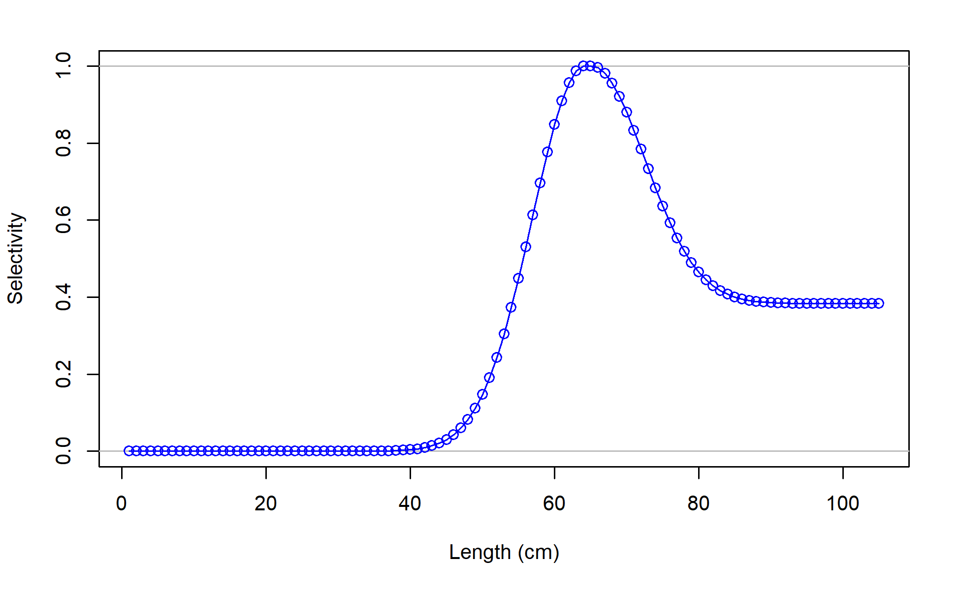
Longline survey selectivity
Current shape of longline survey selectivity can be traced back to the 2016 assessment in which the longline survey was first used (dome-shaped after 60ish cm)
Primary question: is there evidence for the dome-shaped selectivity?
Are larger cod deeper and smaller cod shallower?
What is the longline survey overlap with cod depth distribution by size?

Slide 59
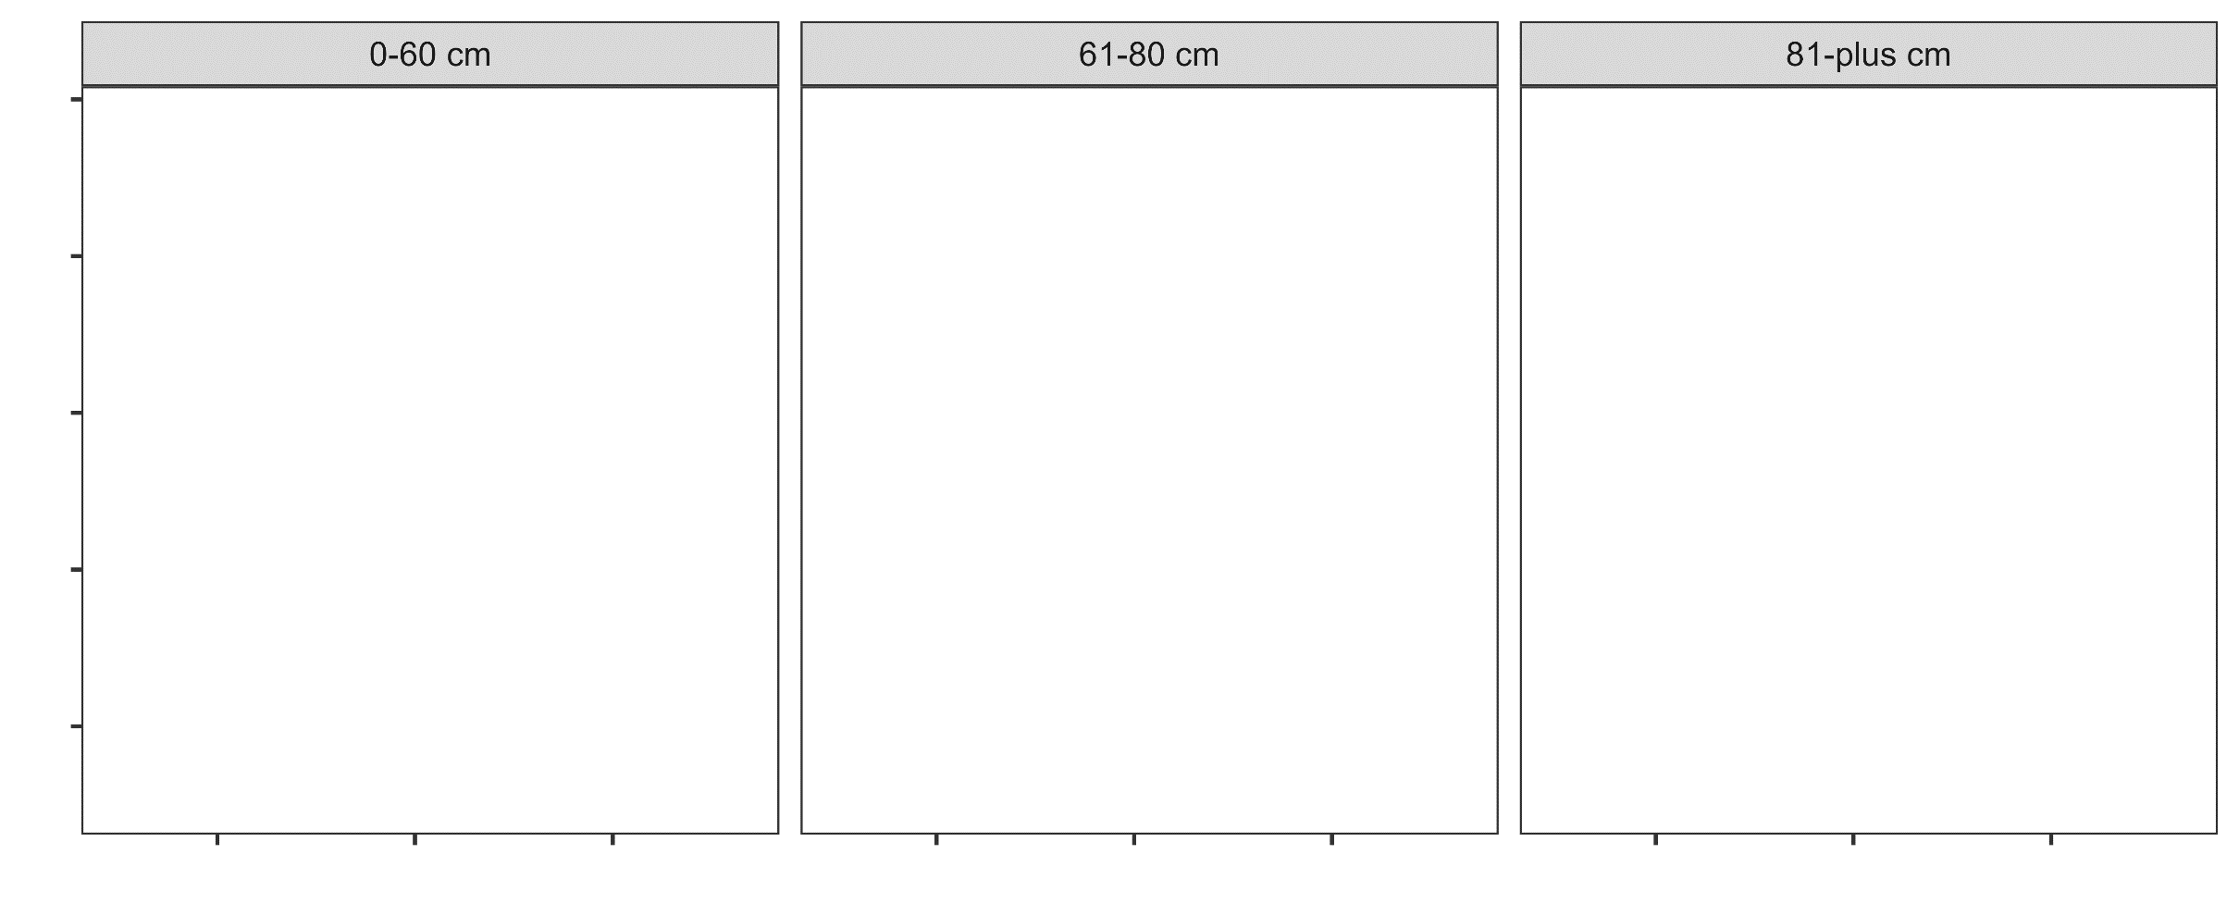
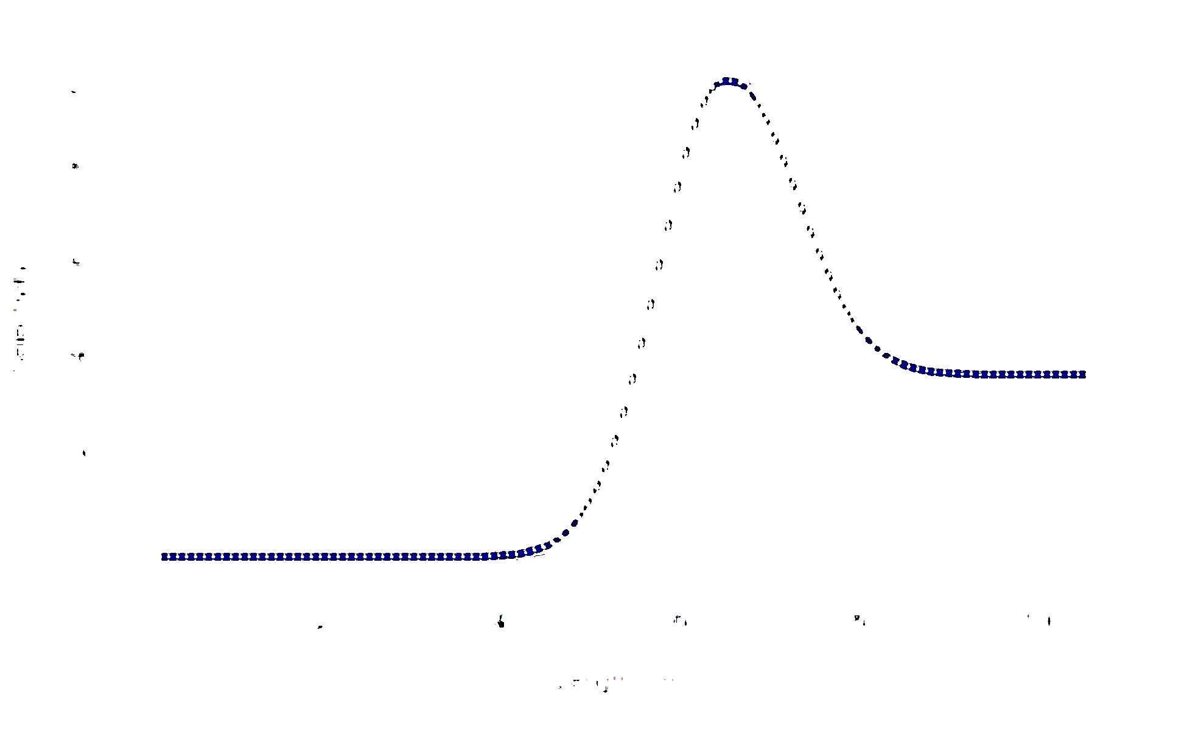
Longline survey selectivity
What is cod depth distribution by size?

Slide 60
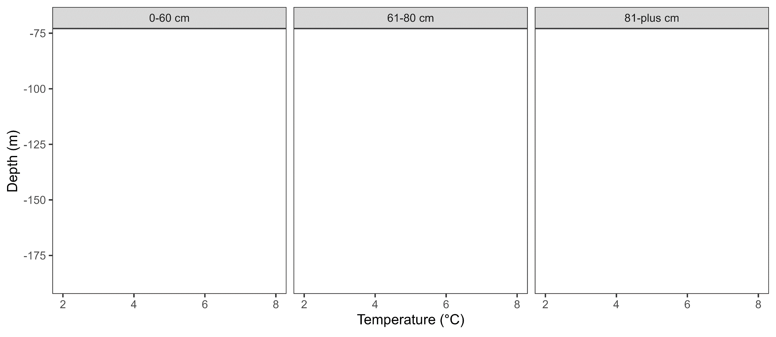
Longline survey selectivity
What is cod depth distribution by size?

Slide 61
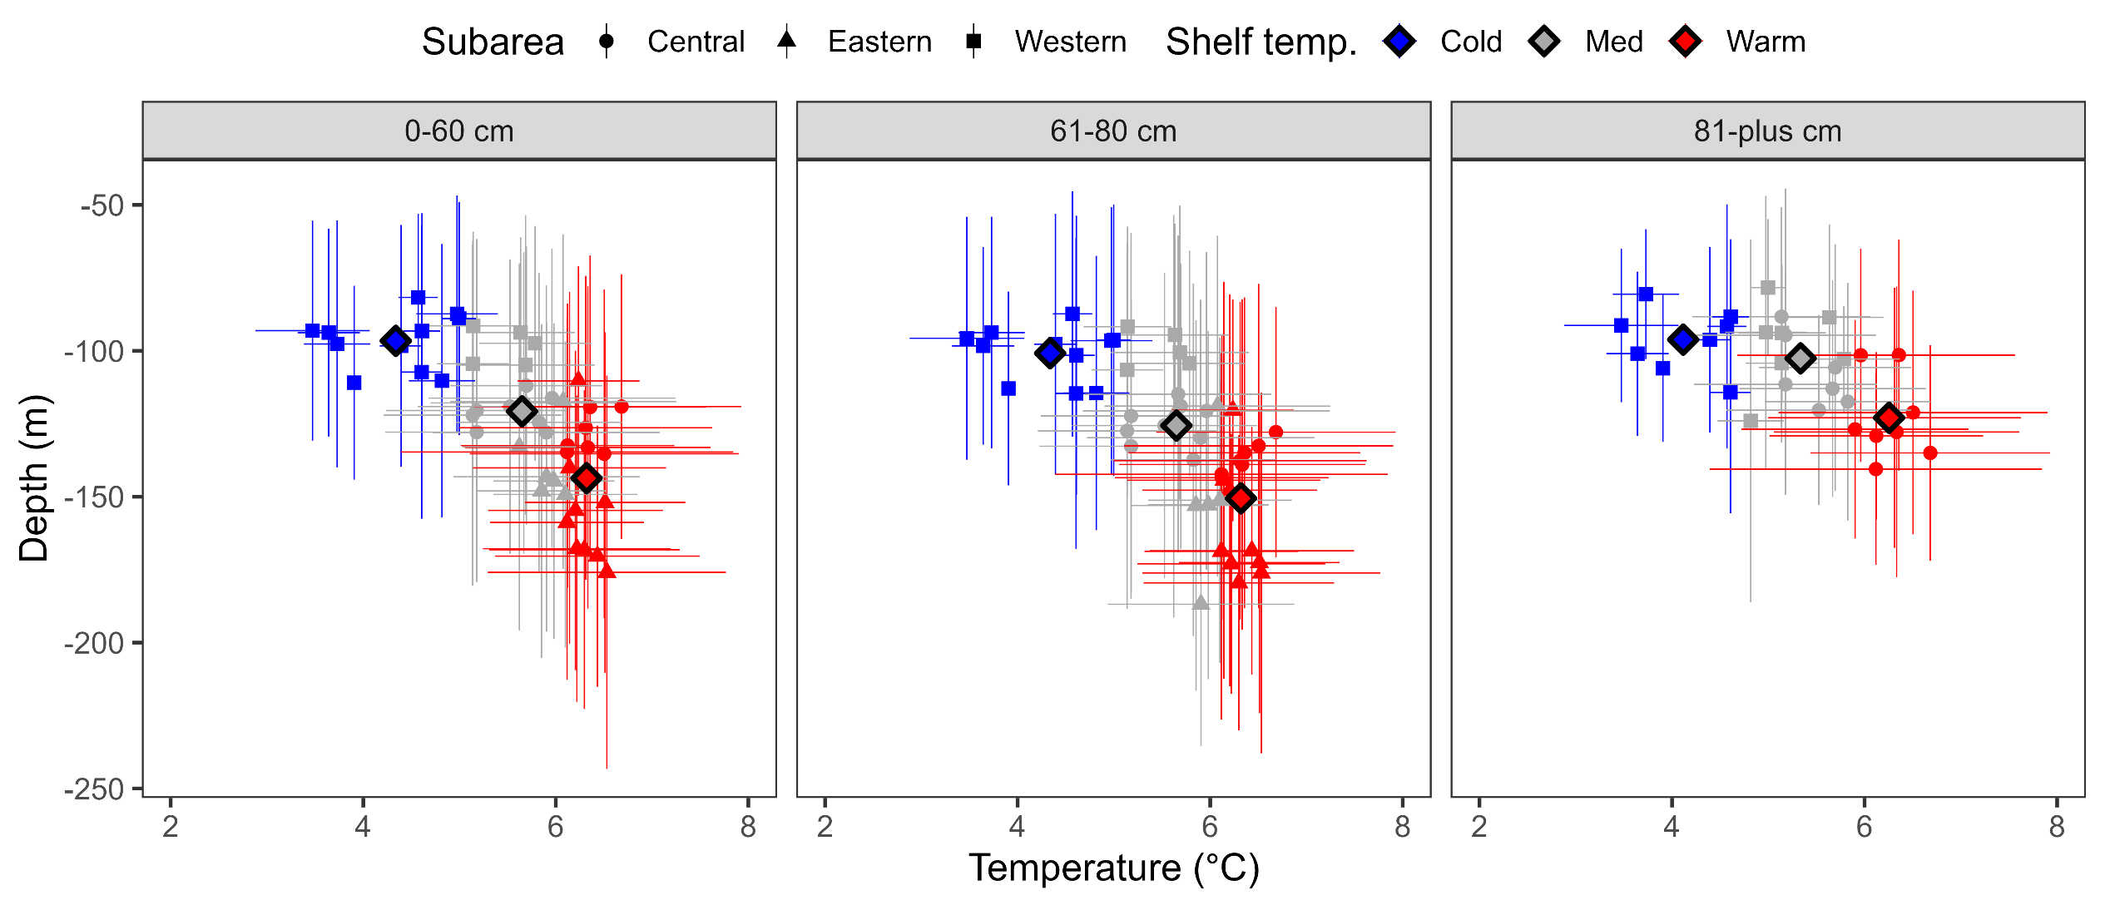
Longline survey selectivity
What is cod depth distribution by size?

Slide 62
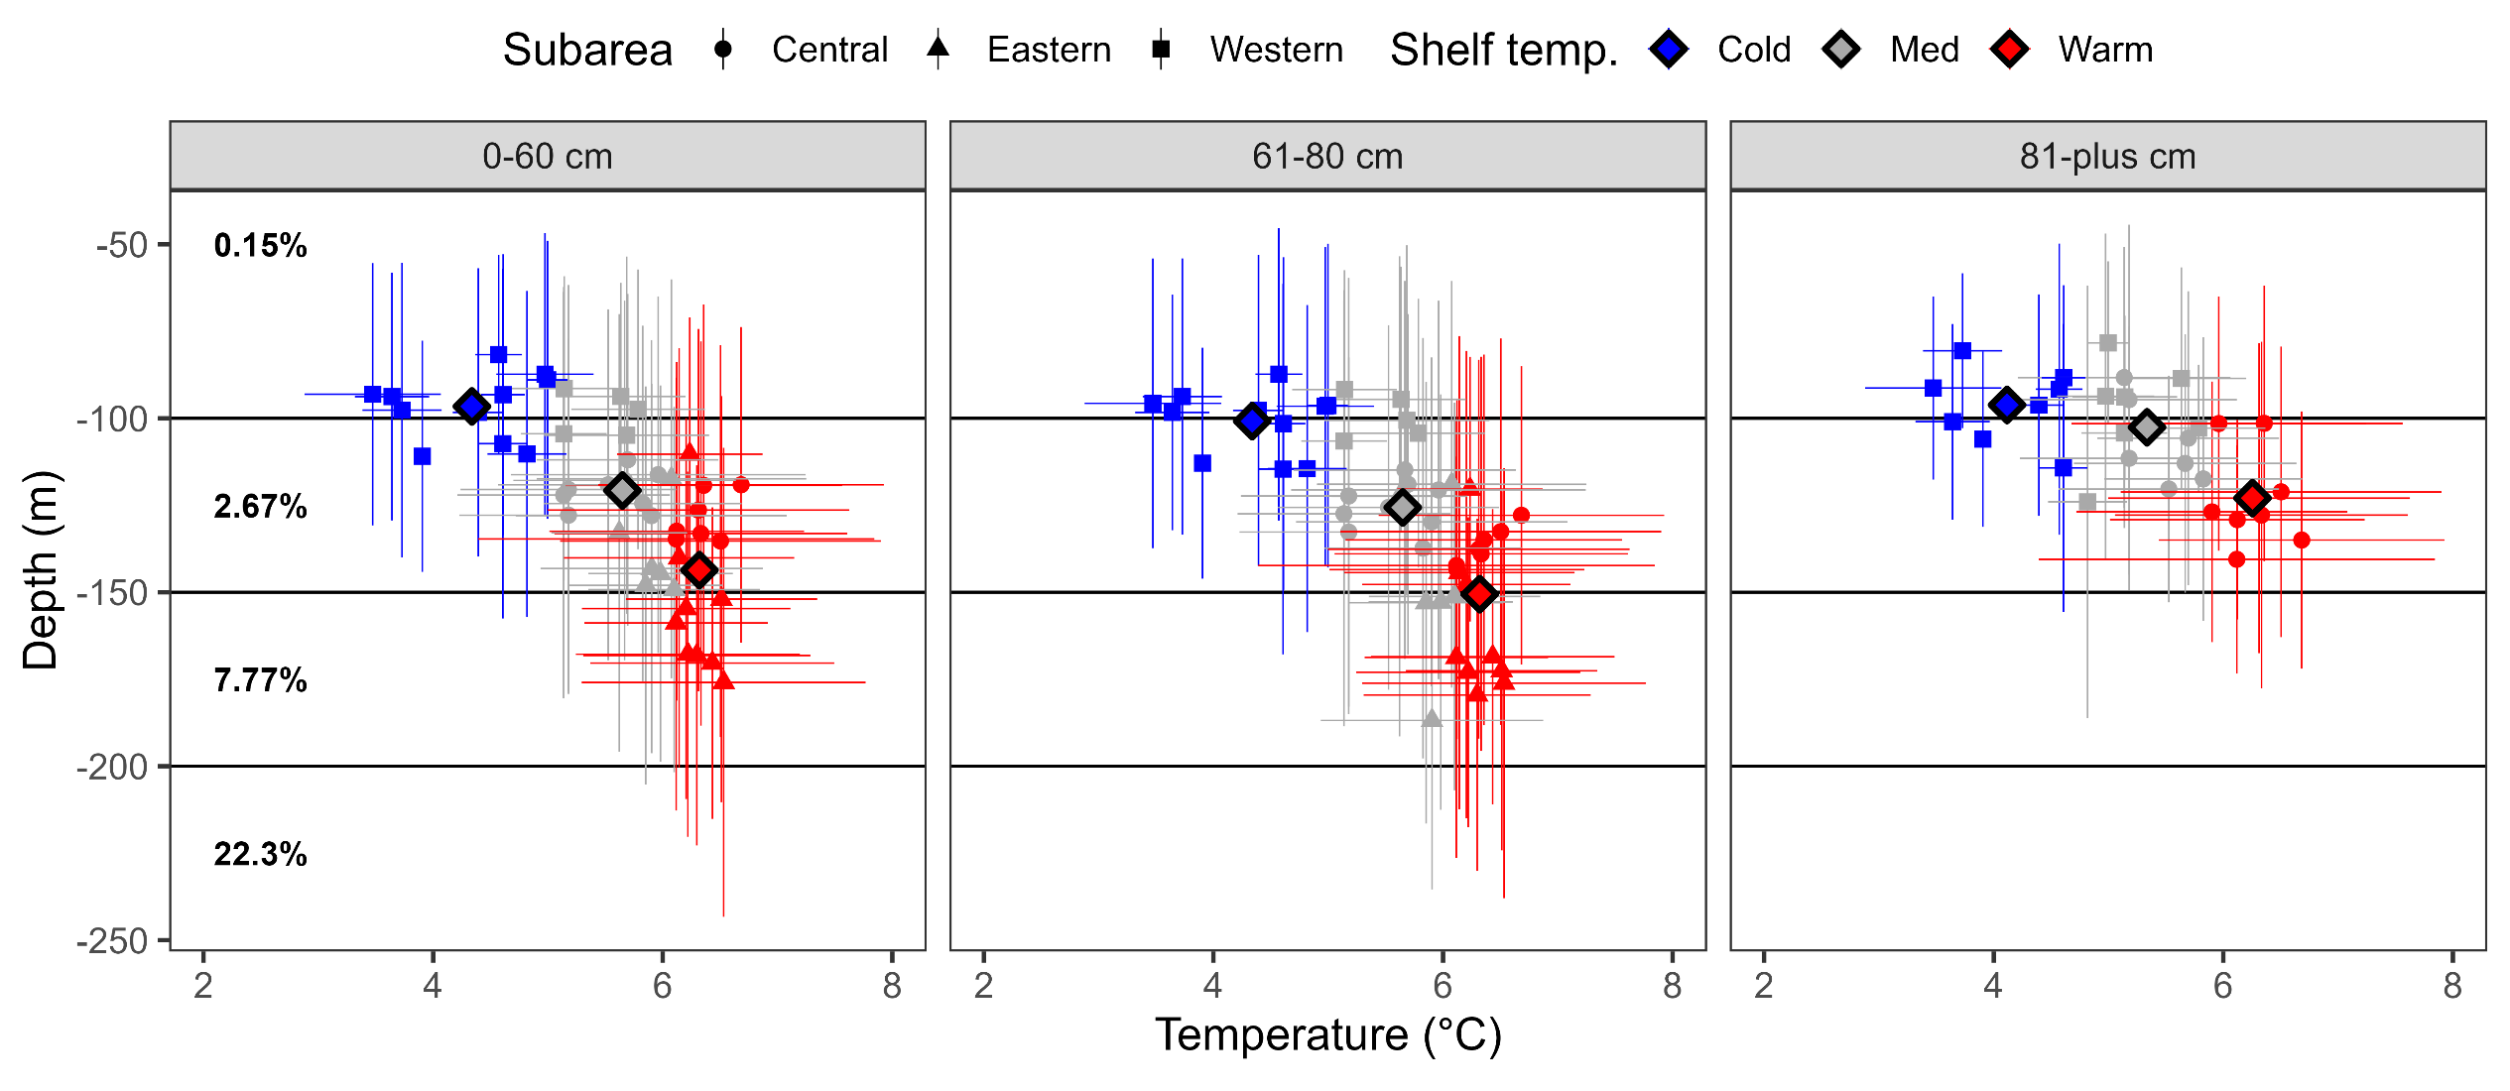
Longline survey selectivity
What is cod depth distribution by size? What is overlap with LLS?

Slide 63
More on selectivity
The SSC requests a thorough revaluation of the current modeling approach for survey selectivity and catchability, including alternatives to the current selectivity blocks in the trawl survey, and alternatives to a strongly dome-shaped selectivity in the longline survey, and whether selectivity rather than catchability is more appropriately modeled with a time-varying temperature covariate.

Slide 64
More on selectivity
The SSC requests a thorough revaluation of the current modeling approach for survey selectivity and catchability, including alternatives to the current selectivity blocks in the trawl survey, and alternatives to a strongly dome-shaped selectivity in the longline survey, and whether selectivity rather than catchability is more appropriately modeled with a time-varying temperature covariate.

Slide 65
Trawl and longline survey selectivity
Two model sensitivities run to start addressing these SSC comments:
Force trawl survey to be time-invariant and asymptotic
Force longline survey to be asymptotic

Slide 66


Trawl and longline survey selectivity
Both sensitivities indicate that current modeling of selectivity provides better data fit and is preferred by AIC
 | 2019.1e.5cm-2024 | Trawl | Longline
# parameters | 194 | 183 | 193
AIC | 4336.02 | 4343.20 | 4427.46
ΔAIC | 0.00 | 7.18 | 91.44
TOTAL | 1974.01 | 1988.6 | 2020.73
Catch | 1.91E-12 | 1.69E-12 | 6.91E-12
Survey | 2.16 | 8.53 | 4.81
Length_comp | 1330.40 | 1339.59 | 1379.19
Age_comp | 633.31 | 633.89 | 630.94

Slide 67

Trawl and longline survey selectivity
But, are differences in model estimates… and management quantities (in a non-linear way)
Model | 2025 SSB | SSB_PER | SB100 | F40
2019.1e.5cm-2024 | 47,580 | 29.9% | 158,893 | 0.42
Twl selex | 51,767 | 32.6% | 158,851 | 0.47
LL selex | 42,799 | 30.0% | 142,462 | 0.50

Slide 68
Trawl and longline survey selectivity
When it comes to trawl survey selectivity, not a whole lot gained by adding time-dependence, but there are consequences to investigate further
May produce an ‘unusual’ shape, but dome-shaped longline survey clearly helps model fit better, and looks to be supported by data
But, this form of dome-shaped not only selectivity form out there
And, adding plot/text that explains how dome-shaped selectivity supported by data will be added to SAFE
But wait, there’s more…

Slide 69
More on selectivity
The SSC requests a thorough revaluation of the current modeling approach for survey selectivity and catchability, including alternatives to the current selectivity blocks in the trawl survey, and alternatives to a strongly dome-shaped selectivity in the longline survey, and whether selectivity rather than catchability is more appropriately modeled with a time-varying temperature covariate.

Slide 70
Longline survey selectivity
Part 2 of starting investigations:
Compare between environmental link with selectivity parameters vs catchability
5 estimated selectivity parameters, applied environmental link one-at-a-time

Slide 71
Longline survey selectivity
Some selectivity parameters have lower total objective
Combining results in AIC ‘preferred’ model overall
 | 2019.1e.5cm-2024 | peak | top_logit | ascend_se | descend_se | start_logit | combined
# params | 194 | 194 | 194 | 194 | 194 | 194 | 196
AIC | 4336.02 | 4332.84 | 4344.14 | 4331.54 | 4343.72 | 4346.78 | 4328.52
ΔAIC | 7.50 | 4.32 | 15.62 | 3.02 | 15.20 | 18.26 | 0.00
TOTAL | 1974.01 | 1972.42 | 1978.07 | 1971.77 | 1977.86 | 1979.39 | 1968.26
Catch | 1.91E-12 | 2.46E-12 | 2.19E-12 | 2.47E-12 | 2.24E-12 | 2.19E-12 | 1.36E-12
Survey | 2.16 | 5.81 | 8.92 | 6.31 | 9.73 | 11.58 | 2.00
Length | 1330.40 | 1325.67 | 1327.02 | 1324.28 | 1326.17 | 1326.05 | 1324.75
Age | 633.31 | 632.93 | 634.22 | 633.18 | 634.03 | 633.84 | 633.33

Slide 72


Longline survey selectivity
But, doesn’t resolve the shape of selectivity
And back-and-forth in terms of fitting the LL survey the ‘best’
Work is on-going to investigate environmental links (Krista Oke)

Slide 73
More on selectivity
The SSC requests a thorough revaluation of the current modeling approach for survey selectivity and catchability, including alternatives to the current selectivity blocks in the trawl survey, and alternatives to a strongly dome-shaped selectivity in the longline survey, and whether selectivity rather than catchability is more appropriately modeled with a time-varying temperature covariate.

Slide 74
Selectivity vs catchability
Looking through the history of this assessment, it’s a continual story of investigating selectivity vs catchability
Catchability has been fixed, estimated, informed
Selectivity has come in all shapes and forms across age/length and time
What we may have now that they didn’t have then, is an objective way to define input sample size for age/length/CAAL data
Does it matter?

Slide 75



Selectivity vs catchability
Relative ISS between surveys/fishery fleets has direct implications on model estimates of selectivity, recruitment, catchability…
Recommend: Get composition data ISS set up first (Longline survey, Fishery-Brett Stacy), then start digging into selectivity vs catchability

Slide 76
Maturity
The SSC supports the GOA GPT recommendation to work up the backlog of maturity data, and further to evaluate trends in maturity, as well as relationships between growth and maturity.

Slide 77


Maturity
Recent tagging studies have provided potential information to update maturity ogive in assessment (Charlotte Levy)
Winter maturity histological collections currently being read, estimated to be completed in mid-November (Sandi Neidetcher)
Observer data used in assessment, Stark (2007) data also available
Looking towards 2025 assessment to update maturity information

